Slide 1



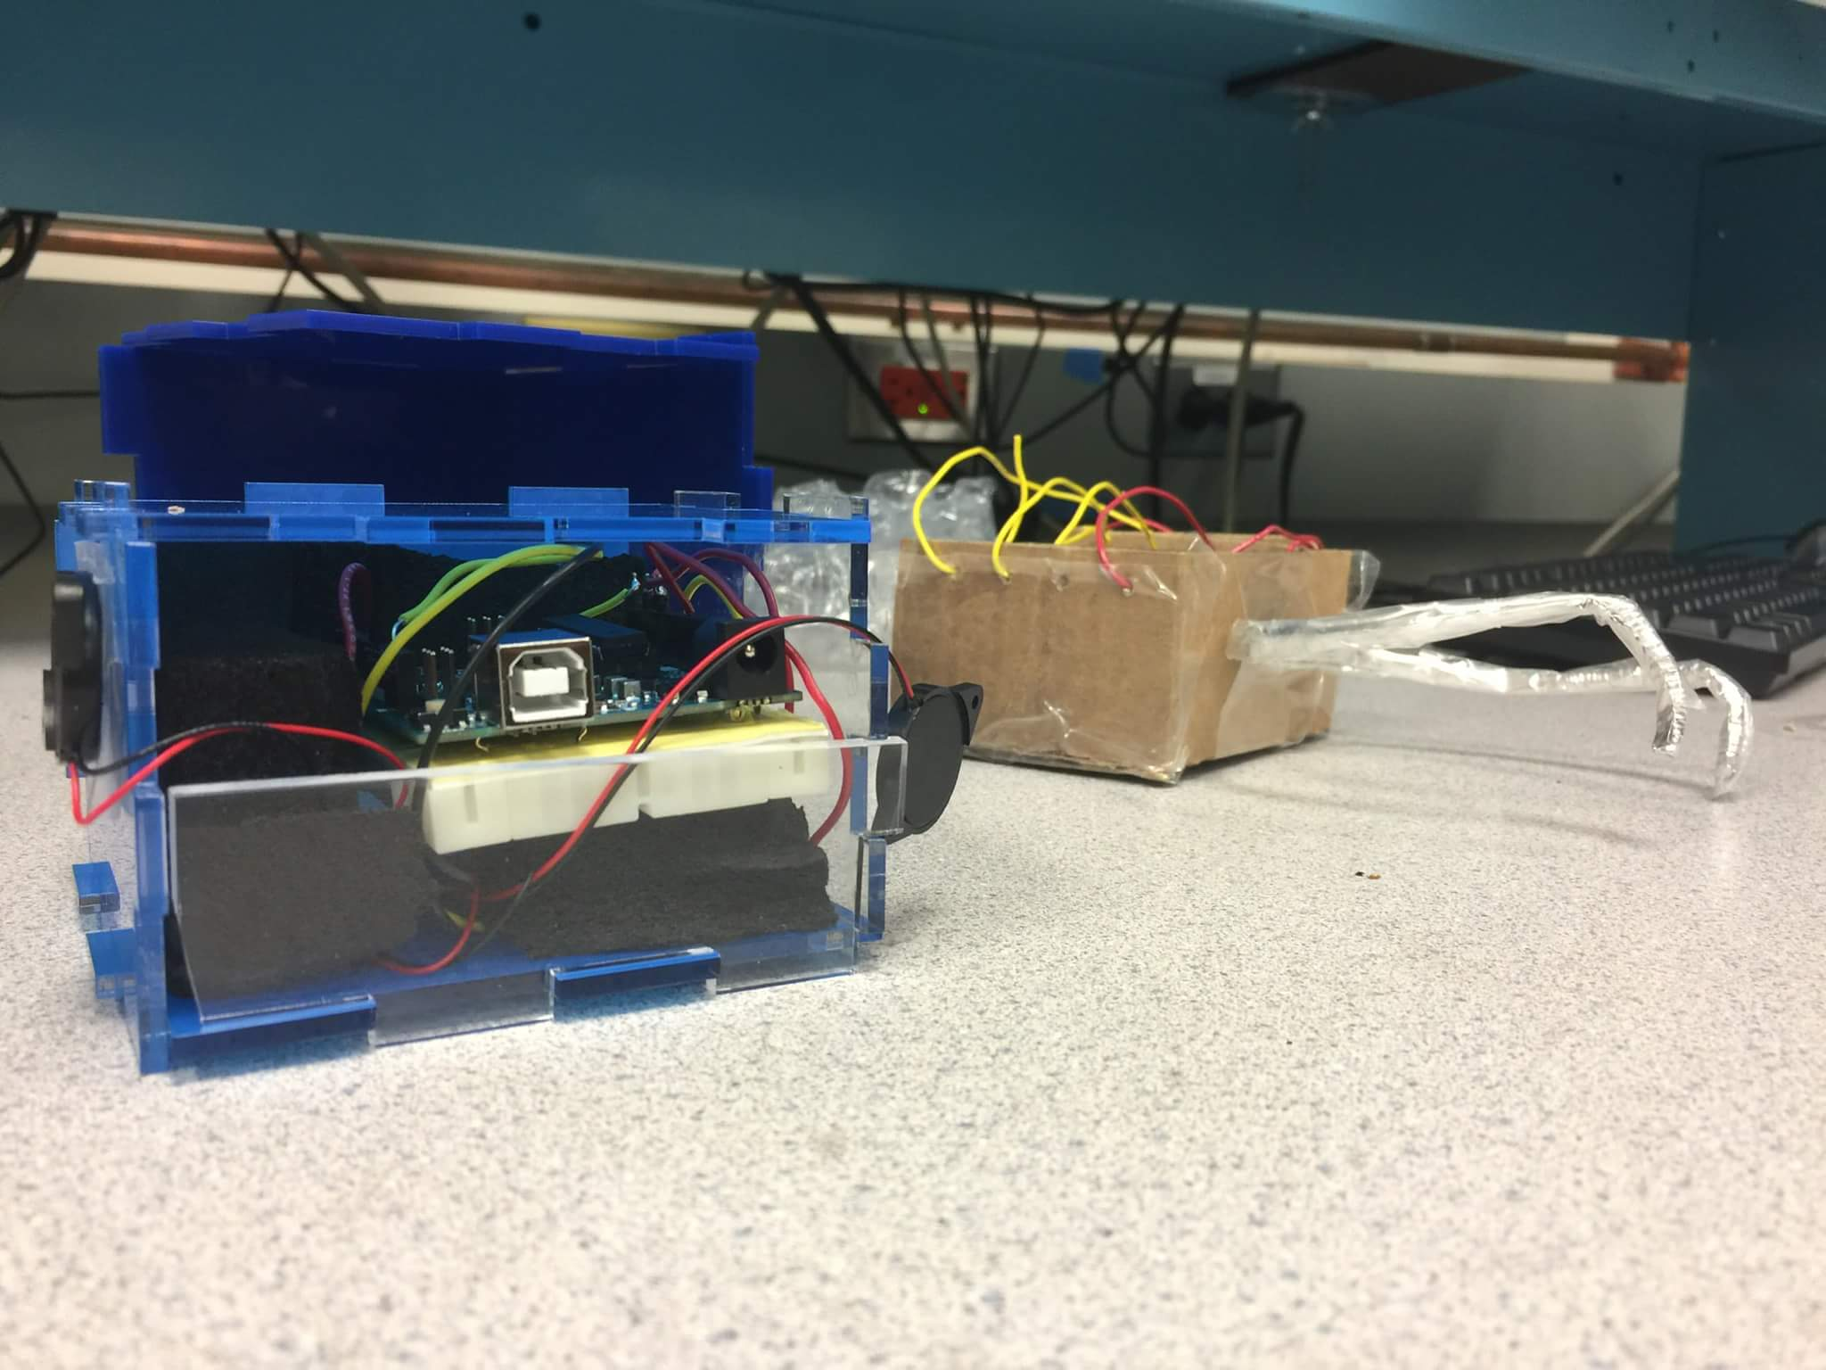
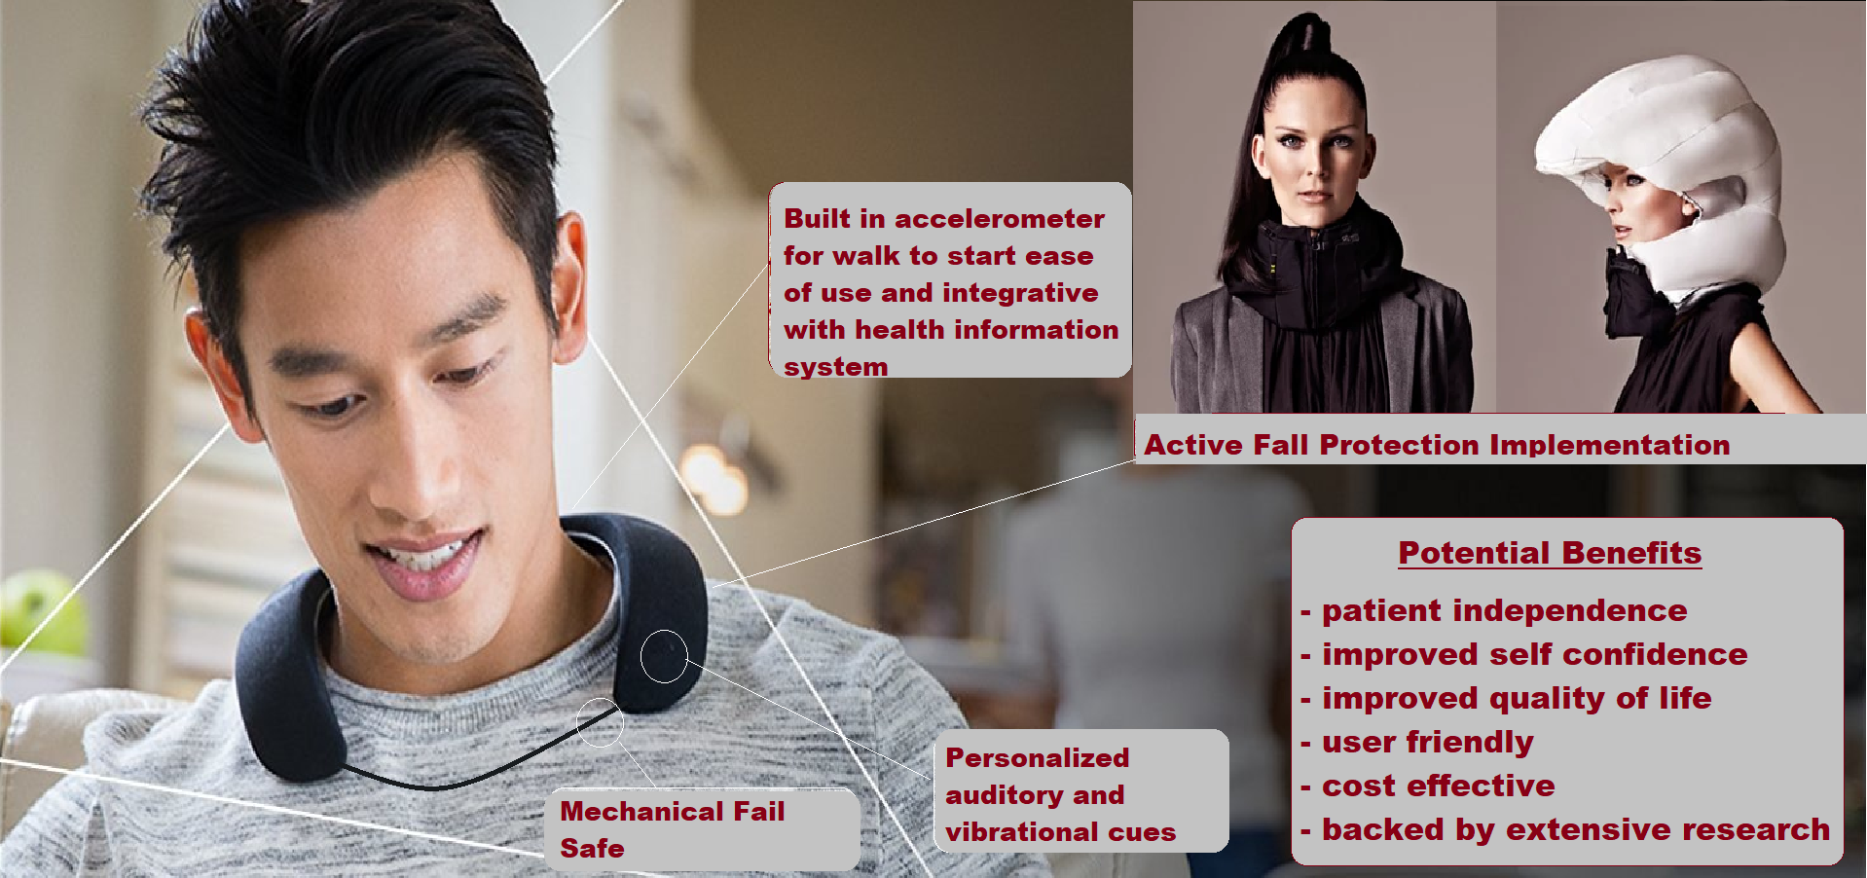
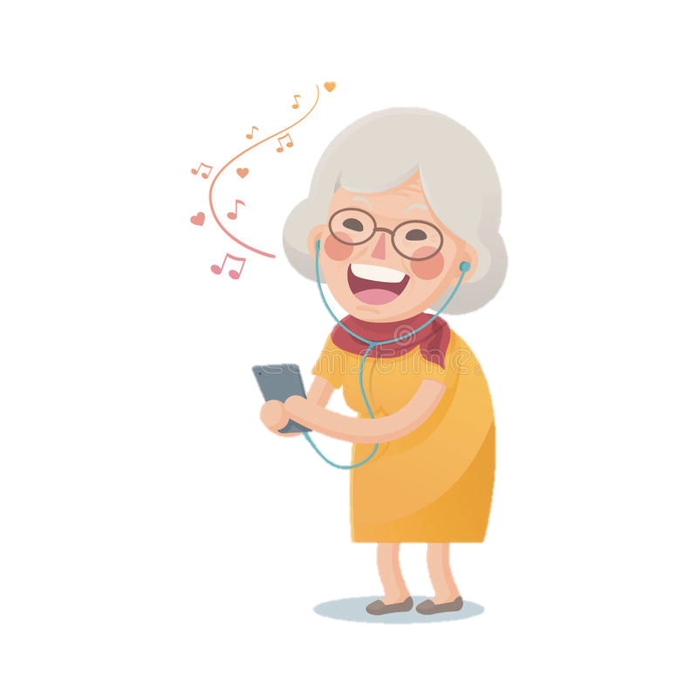
UDIOWALK
Kristen Andersen, Emily Kim, Diana Lee, Su Oner (N1-11)
Value Proposition: Convenient, easy-to-use, and discrete device with an accelerator to detect motion irregularities and activate RAS to can help improve PD patients’ quality of life.
Intent: To take advantage of the research that shows that patients’ gait can be improved by rhythmic auditory stimulation (RAS), and build user-friendly discrete wearable.
Nombela et al, 2013 doi:10.1016/j.neubiorev.2013.08.003 ;Benoit et al, 2014 doi.org/10.1016/j.sbspro.2014.02.378

Slide 2
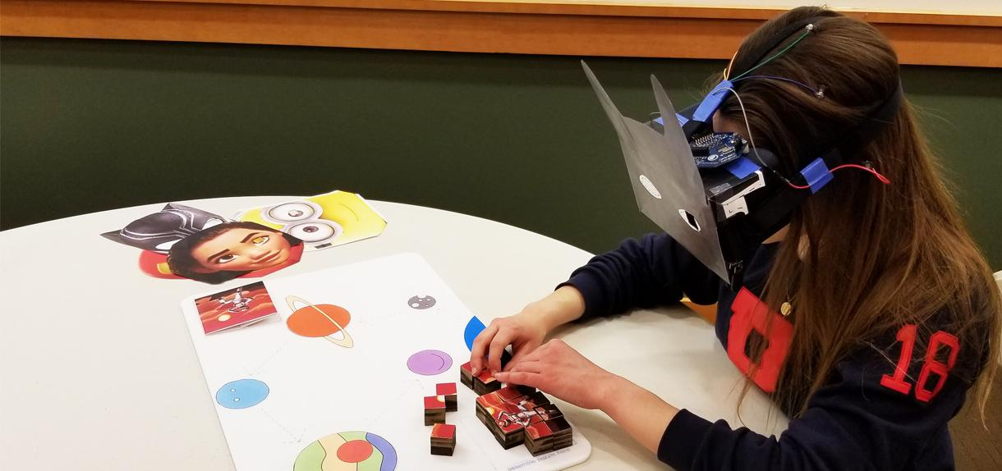
BCI - Epilepsy
BCI – Epilepsy
Enhanced Neuropsychological Testing
Richer Data for Better Results
Team play creates a supportive community
Immersive experience for better engagement
Michael Yates
Varun Sanghvi
Team Number N1-13

Slide 3
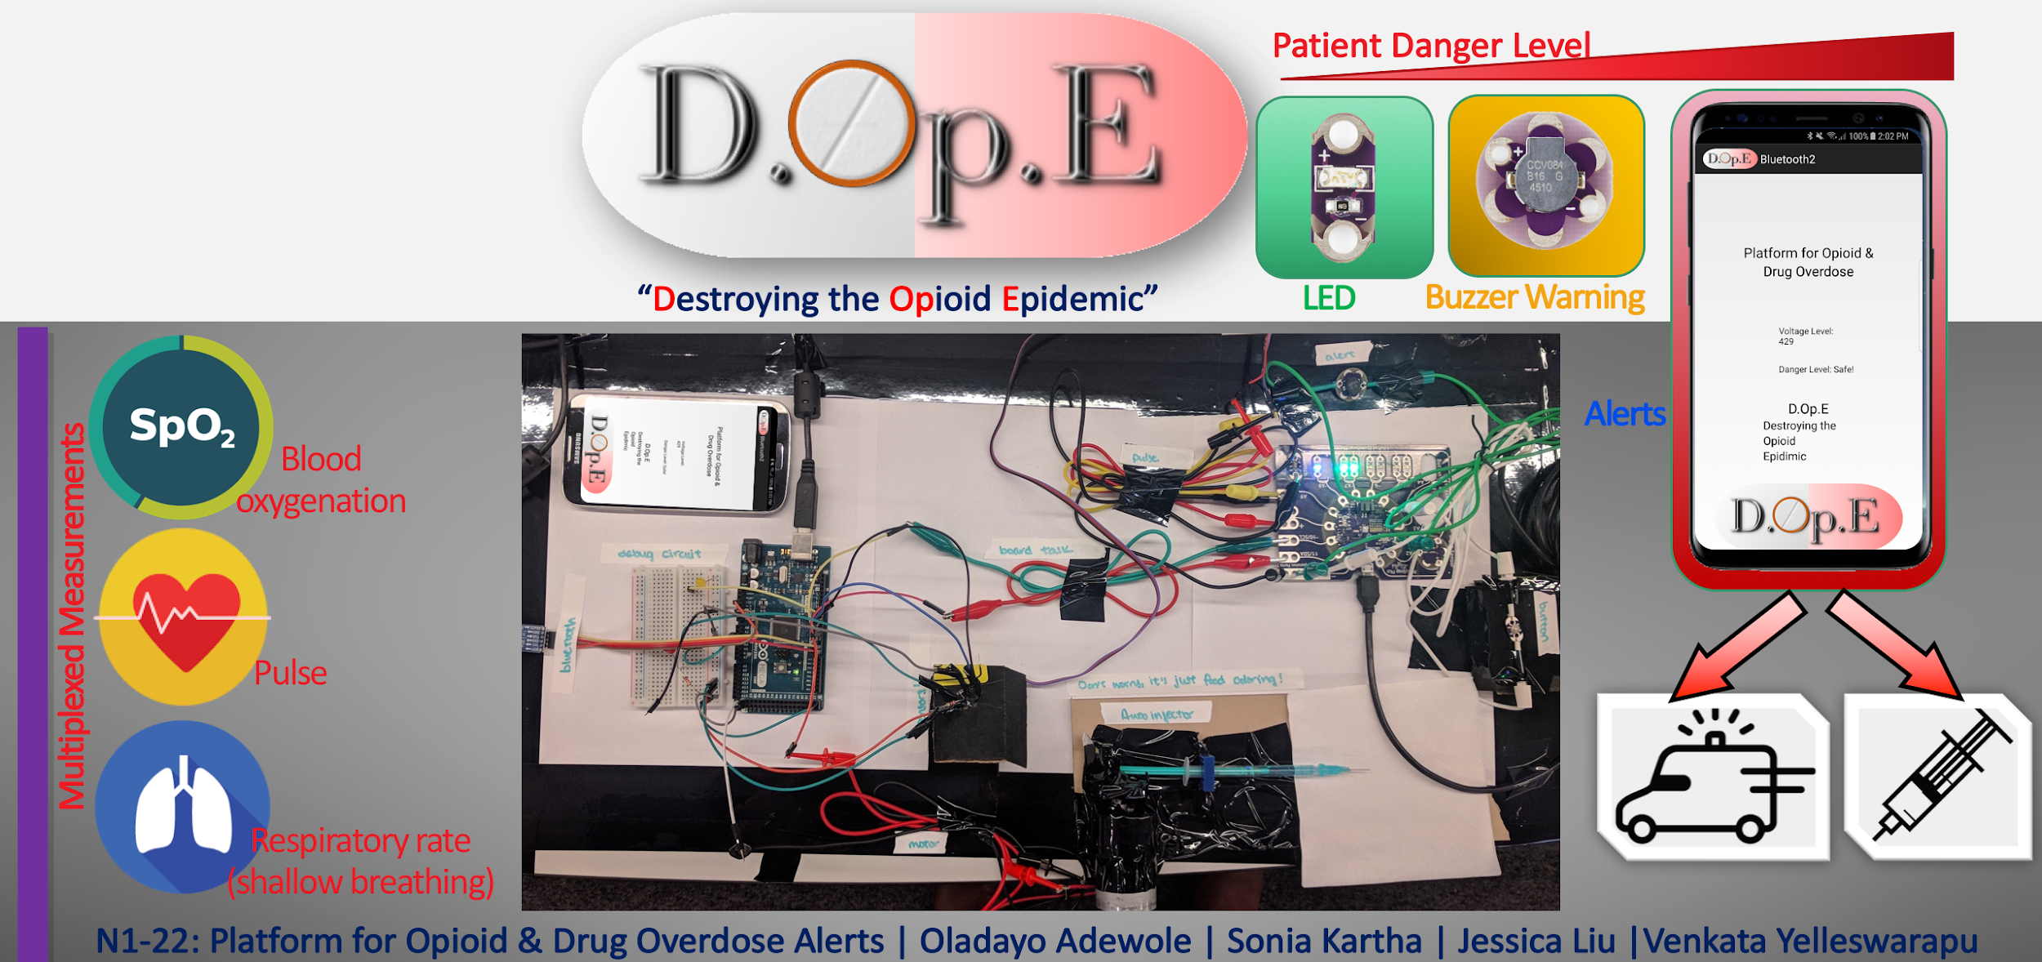
Platform for Opioid & Drug Overdose Alerts
Oladayo Adewole
Sonia Kartha
Jessica Liu
Michael Magaraci
Venkata Yelleswarapu
Team Number N1-22

Slide 4
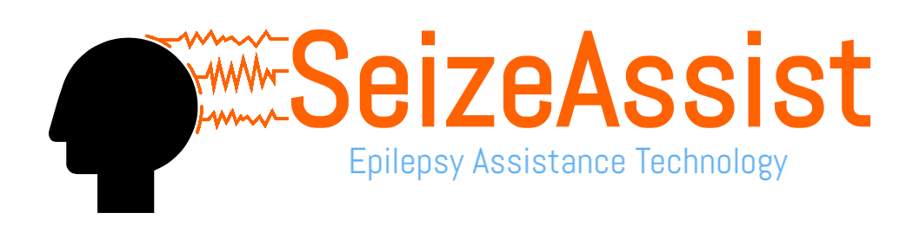
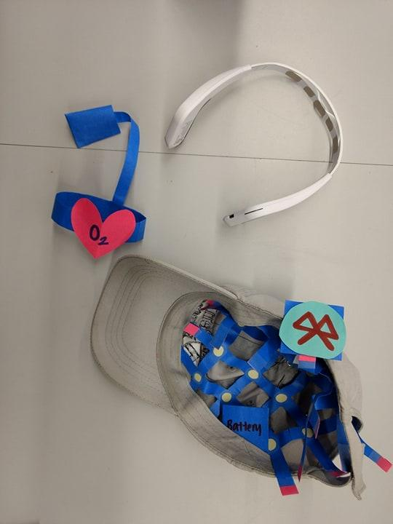
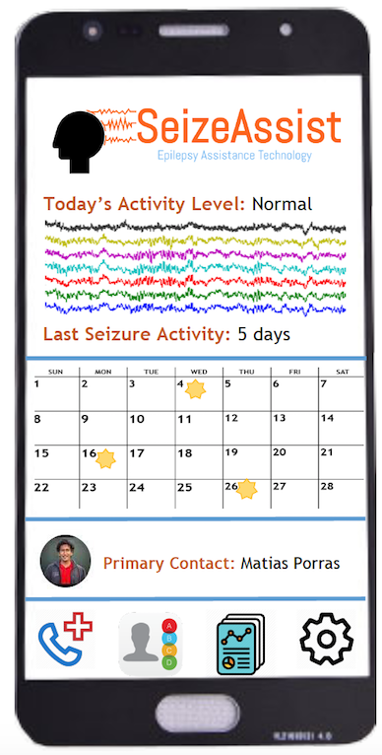
Jaimie Carlson
Rajiv “Deshpande”
Iris Lee
Matias Porras Paniagua
Thomas Arnold
Portable/wearable, continuously monitoring EEG and vital sign system to assuage fears of patients and families of unattended epileptic episode
Team Number N1-23

Slide 5
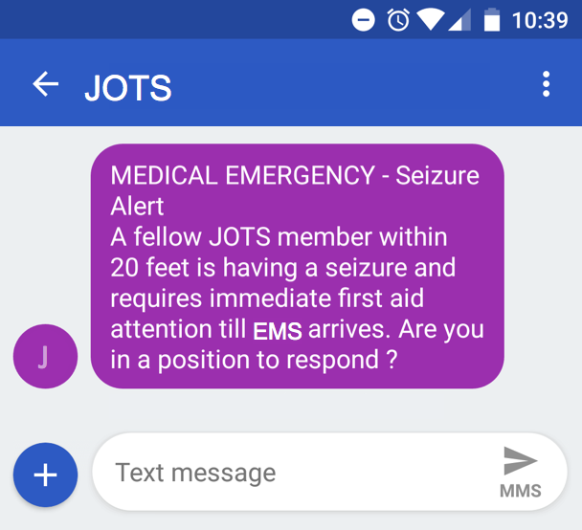
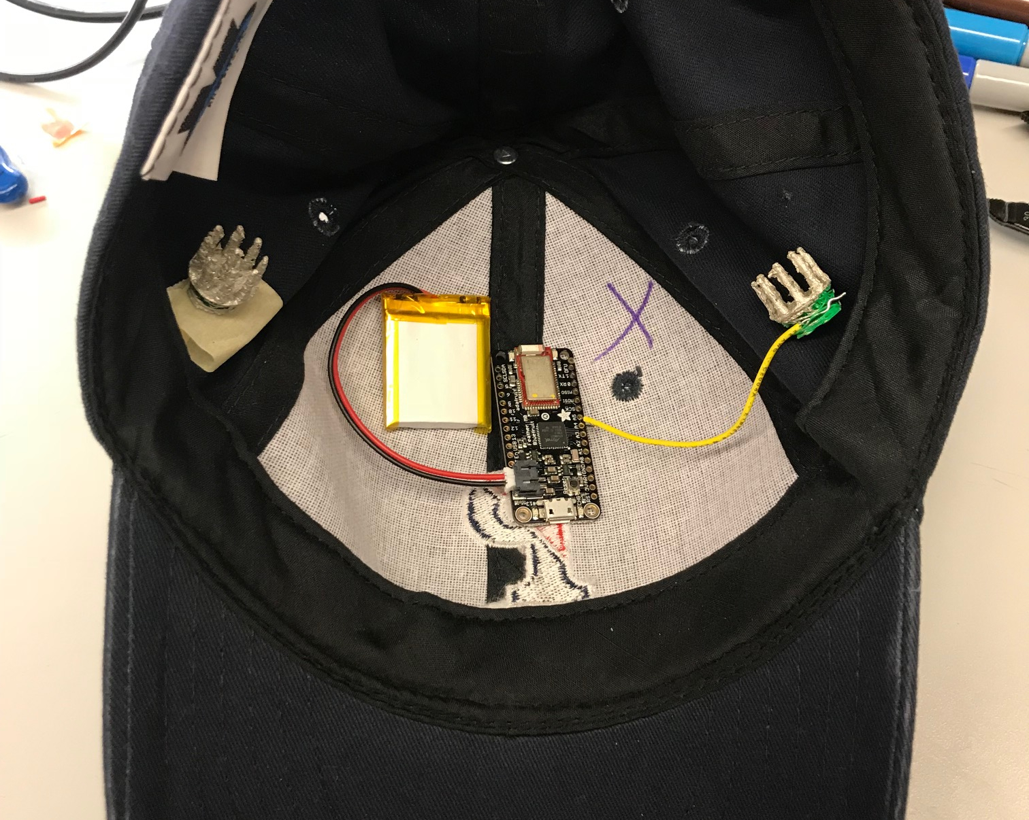
Johnny On the Spots (JOTS)
Jane Evered
Kavya Lakshminarayanan
Murari Ramkumar
Current seizure detection devices alert EMS and caregivers. However there is a time lag between alert and response. JOTS aims at reducing patient and caregiver anxiety about having a seizure in public spaces by mobilizing bystanders.
Team Number N1-28

Slide 6
Nocturnal EEG Headband
Sadhana Marikunte
Hardi Patel
Aris Saxena
Maggie Zhang
Andrew Zheng
Team Number N1-32

Slide 7
ESE - Catalyzers
Samyukta Ramnath
Vedashree Rawalgaonkar
Rachit Saluja
Vipula Sateesh
Alamelu Thinappan
Team Number N1-43

Slide 8
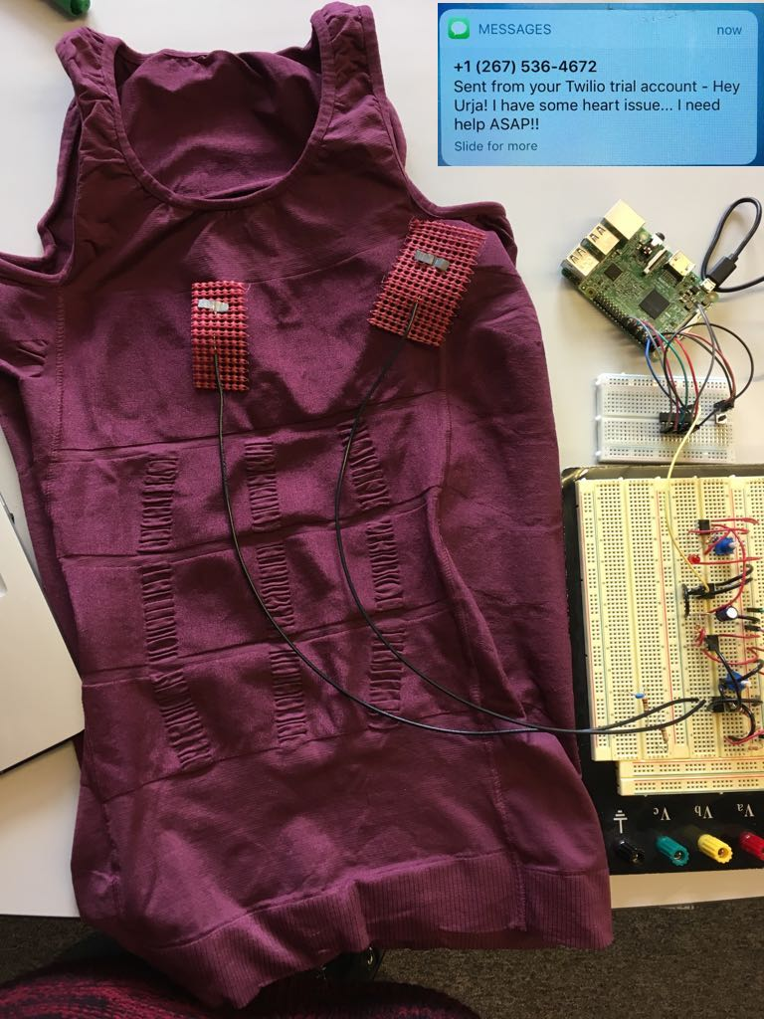
Beat It!
Wearable vest that monitors heart health!
Record your EKG when you feel like it, just press a button!
Remote/self monitoring
No irritating electrodes
Smart, reliable and discrete
Avoids tedious, expensive hospital visits
Send a distress message by pressing a button onthe vest
Team Number N2-5

Slide 9
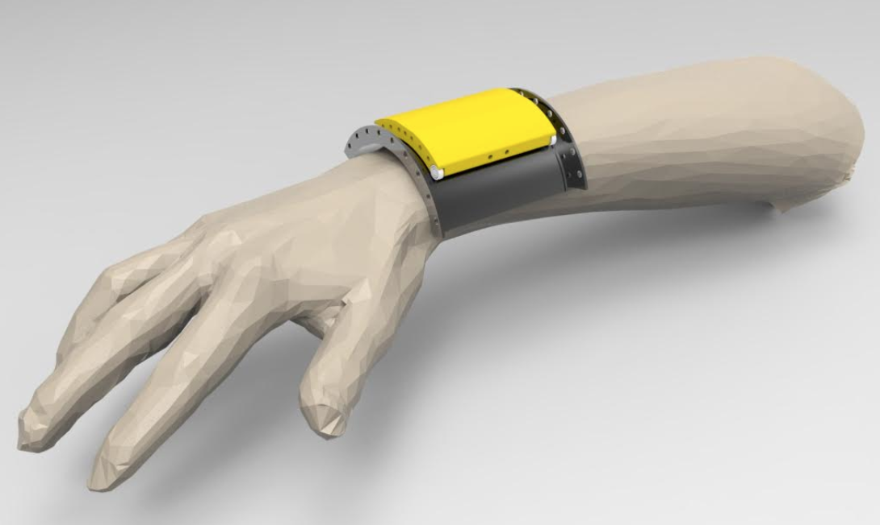
Joshua Chubb
Eli Cohen
Maanav Narula
Maxwell Shoer
Hansell Stedman
Team Minimize
Our product, Minimize, helps Parkinson’s patients reduce their rest tremors by up to 90% by creating a wearable, lightweight bracelet unlike other more intrusive measures.
Team Number N2-20

Slide 10
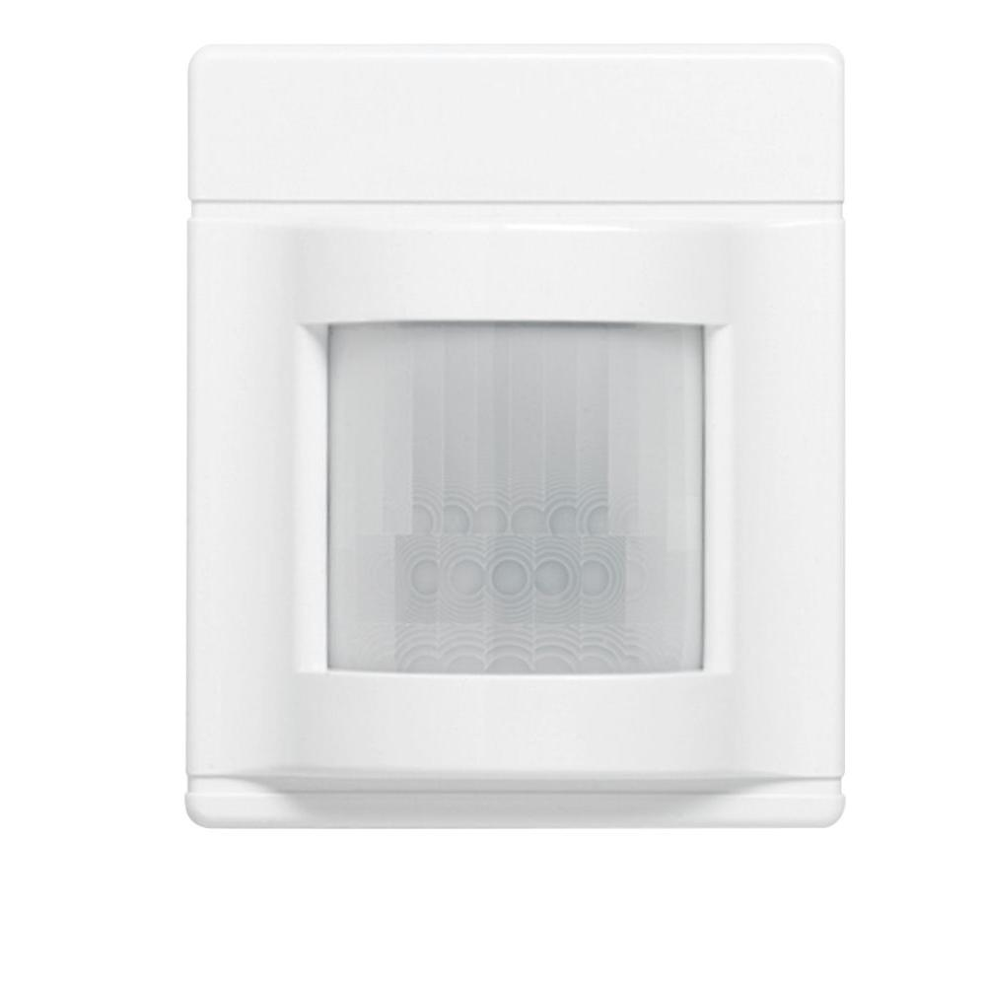
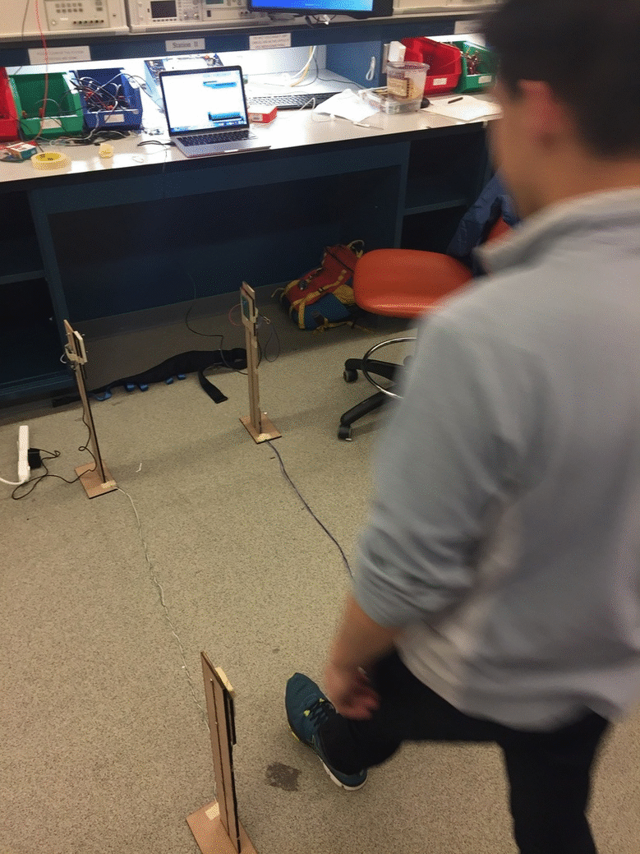
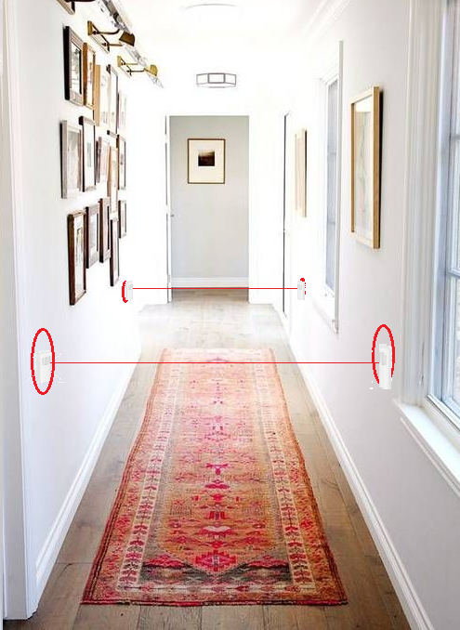
Robo Rehab Lab (InfraStride)
Kevin Bui
Jack Russ
Wilson Torres
Susan Zhao
Team Number N2-29
Notes:
test

Slide 11
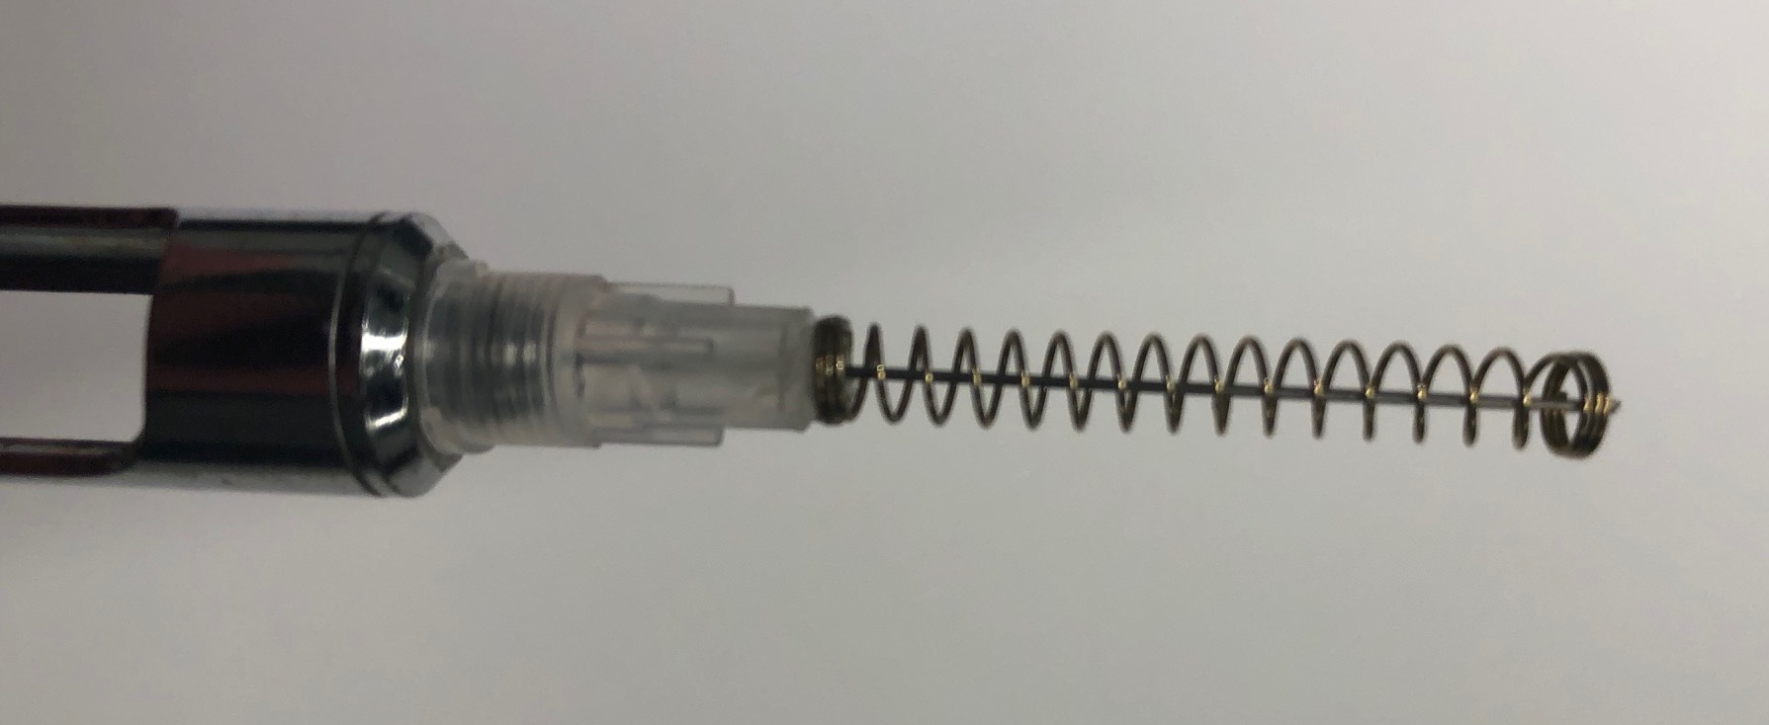
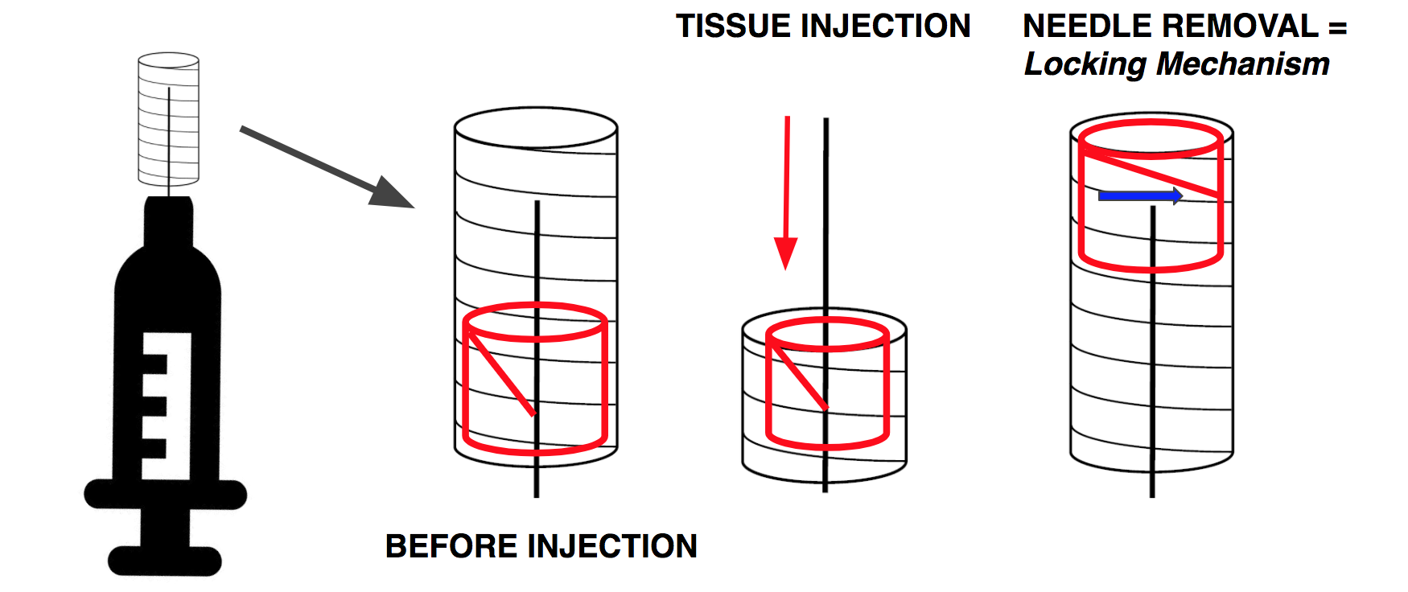
Odontoblasts
Nick Branson
Sam Caruso
Mordy Fried
Samuel Kang
Elizabeth Soulas
Team Number N2-33
Notes:
Our Product aims to address:
Pt Anxiety via sight of needle
Needle Stick injuries

Slide 12
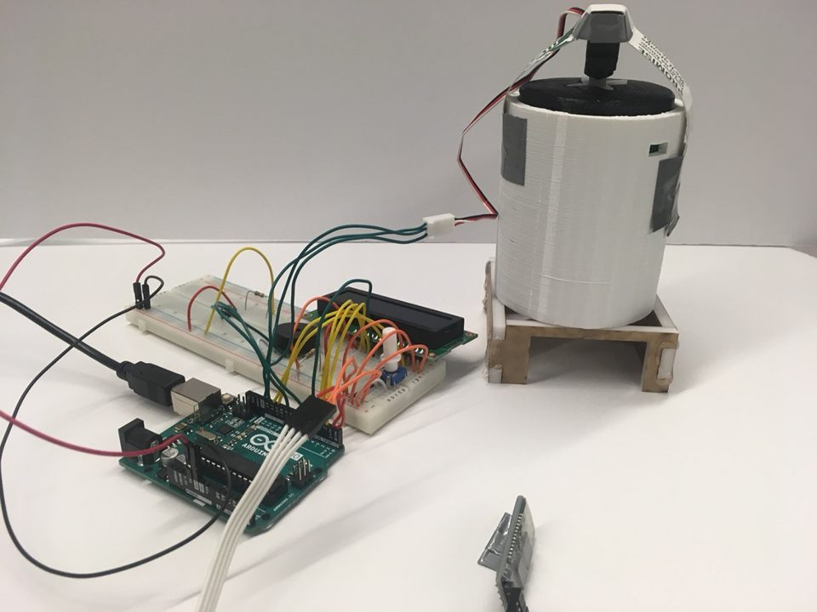
Fifth Dimension
Aleena Brown
Christina Eng
Melanie Hilman
Jackie Peng
Benjamin Porat
Team Number N2-38

Slide 13
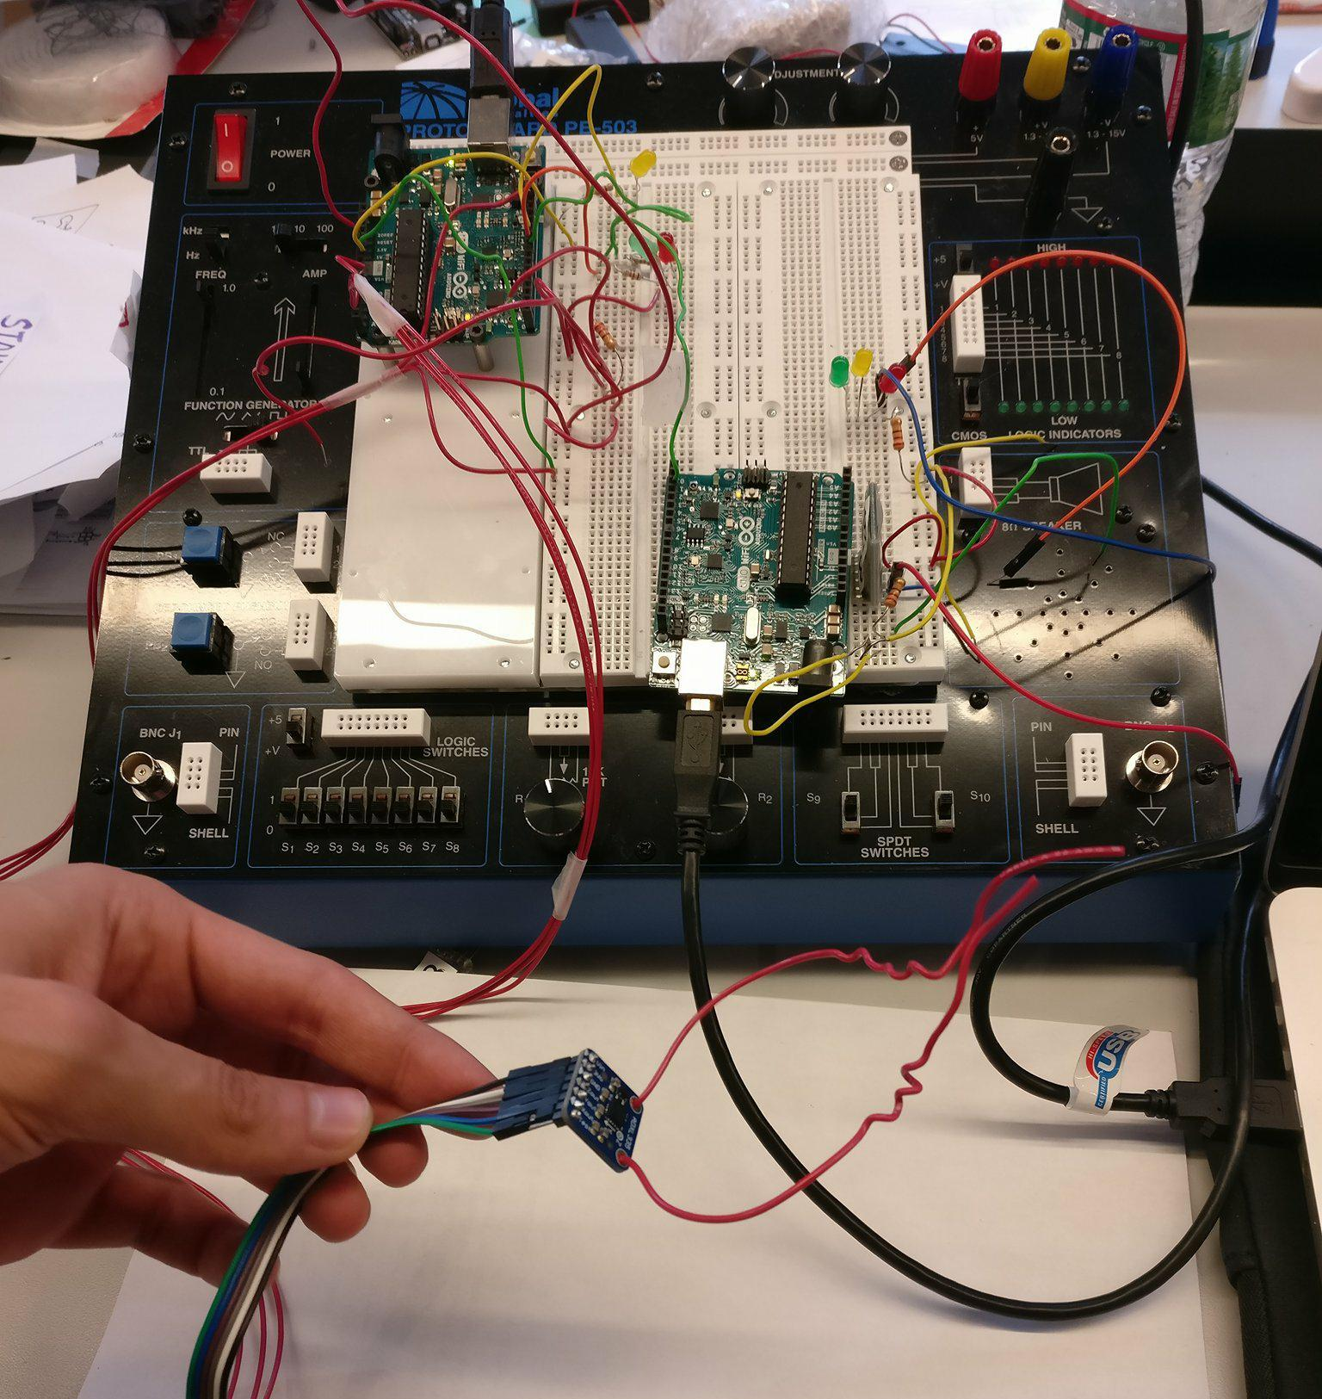
Bonne Vitae Care
Sakshum Chadha
Sona Dadhania
Sohum Daftary
Radhika Gupta
Bela Parekh
Team Number N2-47

Slide 14
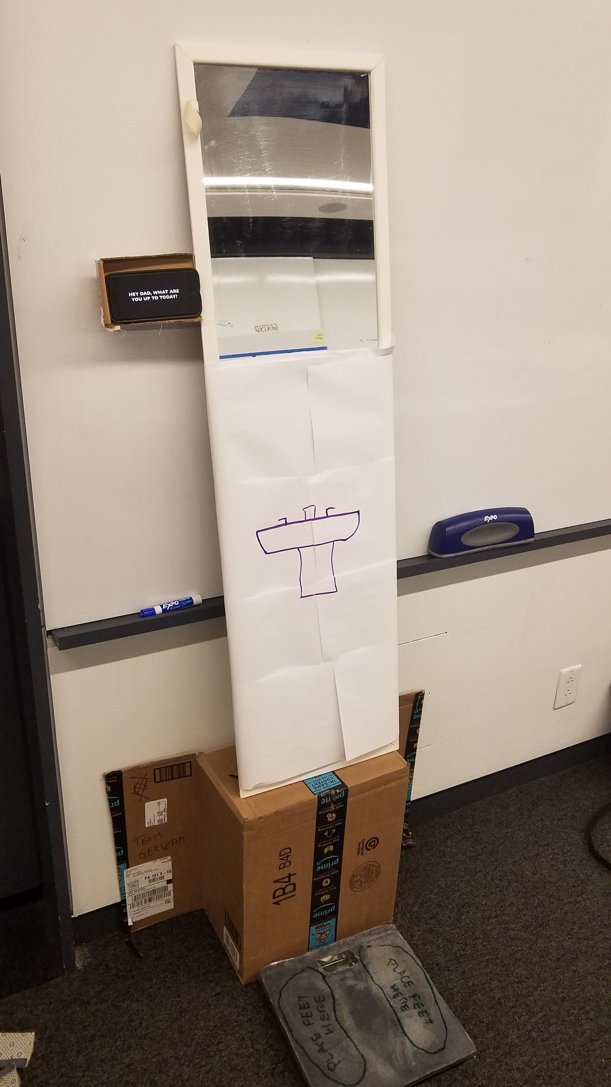
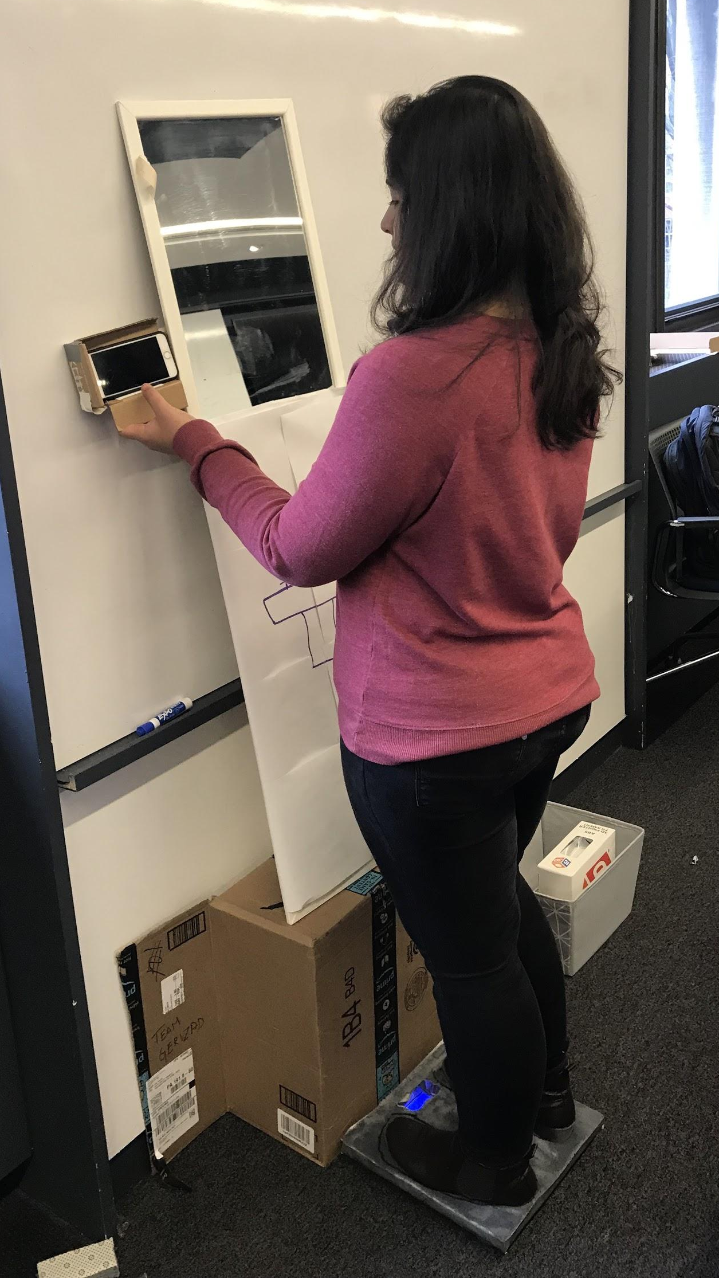
Gerised
Julia Lin
Fair Pisuttisarun
Sahaana Sekhar
Chris Yi
Brian Zhang
Team Number N2-49

Slide 15
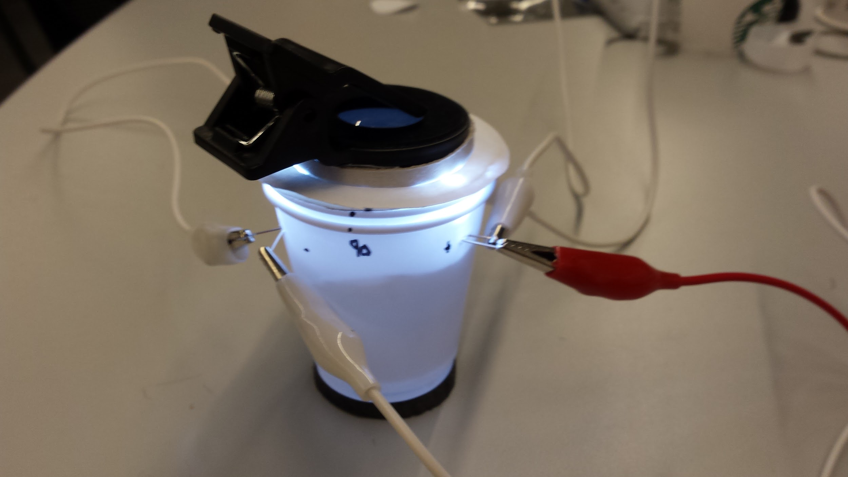
SimpleScope
Nate Bade
Zach Corse
Kevin D'Aquilla
Team Number N3-16

Slide 16
DeNature Solutions
Patrick McClanahan
Christine Allen-Blanchette
Sonia Roberts
Team Number N3-26

Slide 17
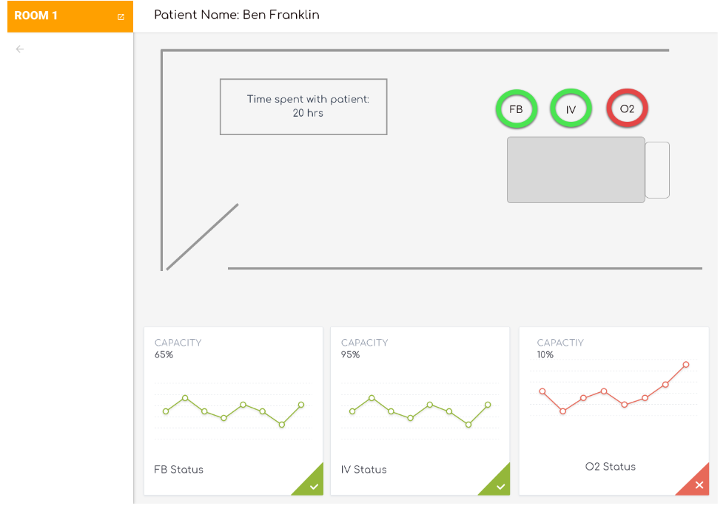
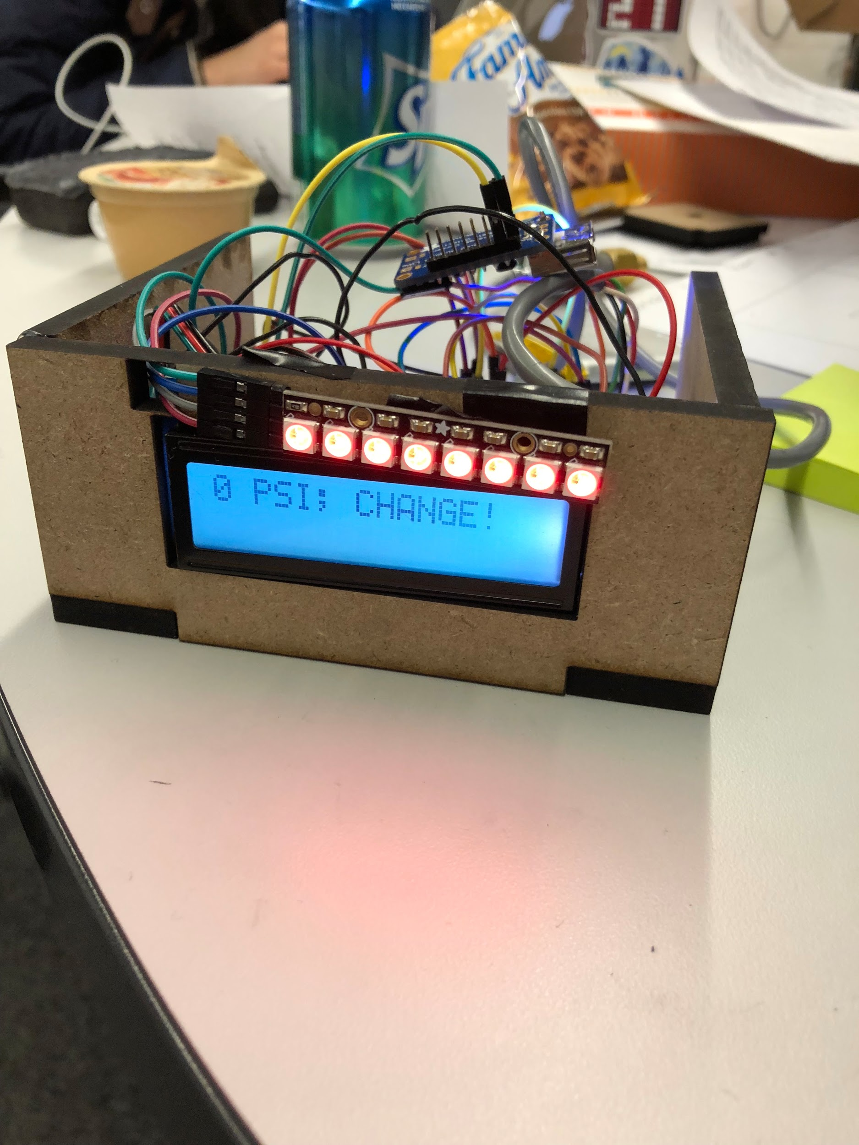
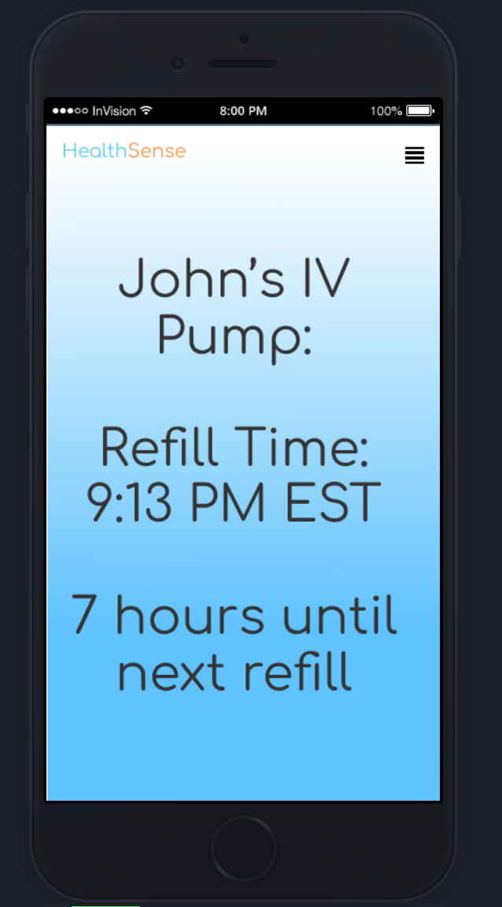
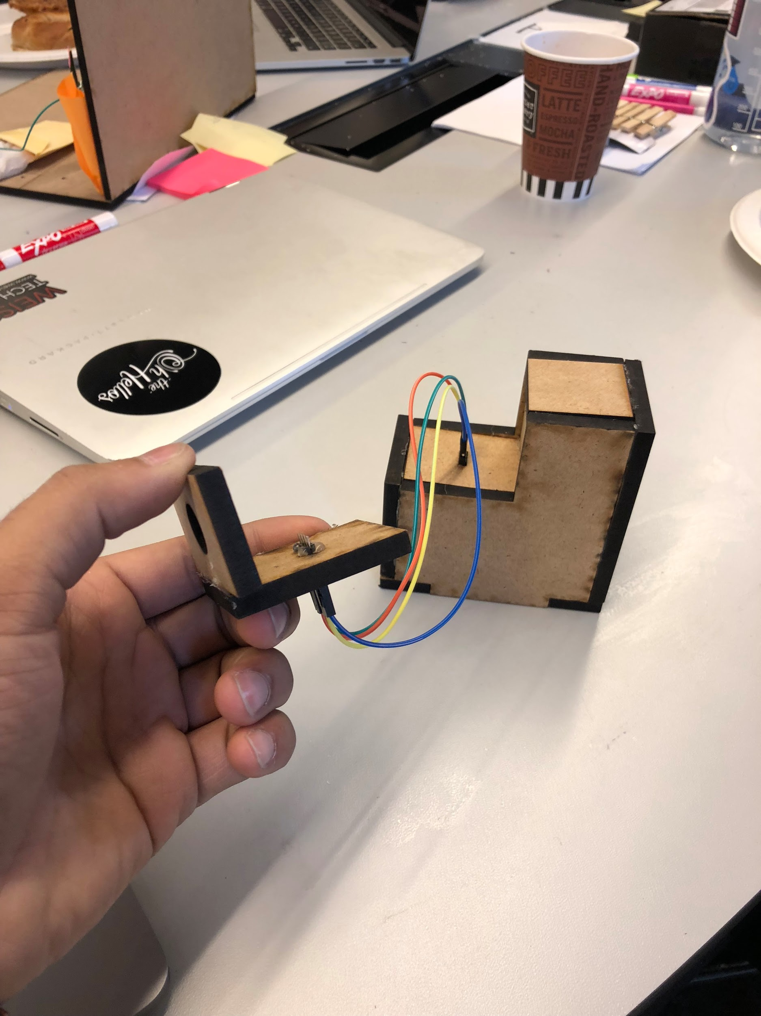
Health Sense
Pranab Krishnan
Adarsh Kulkarni
Jonathan Mairena
Kirti Shenoy
Team Number N3-34

Slide 18
Cardio B
Riddhi Doshi
Prashanth Prakash
Divya Ramesh
Karol Szymula
David Weiss
Team Number N3-35

Slide 19
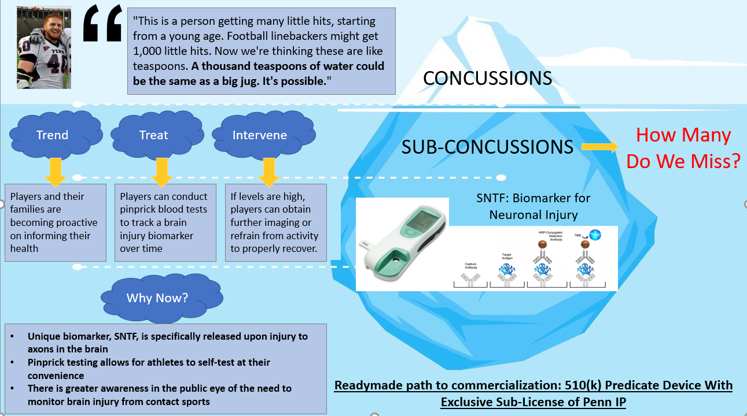
Shake & Make
Team Number N3-39

Slide 20
Team Blue
Fiona La
Daniel Pak
Team Number N3-40

Slide 21
To Be Determined
Liam Dugan
Yueqi Ren
Sadat Shaik
Abhinav Suri
Jared Winograd
Team Number N3-42

Slide 22
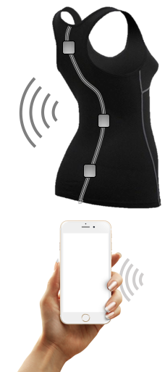
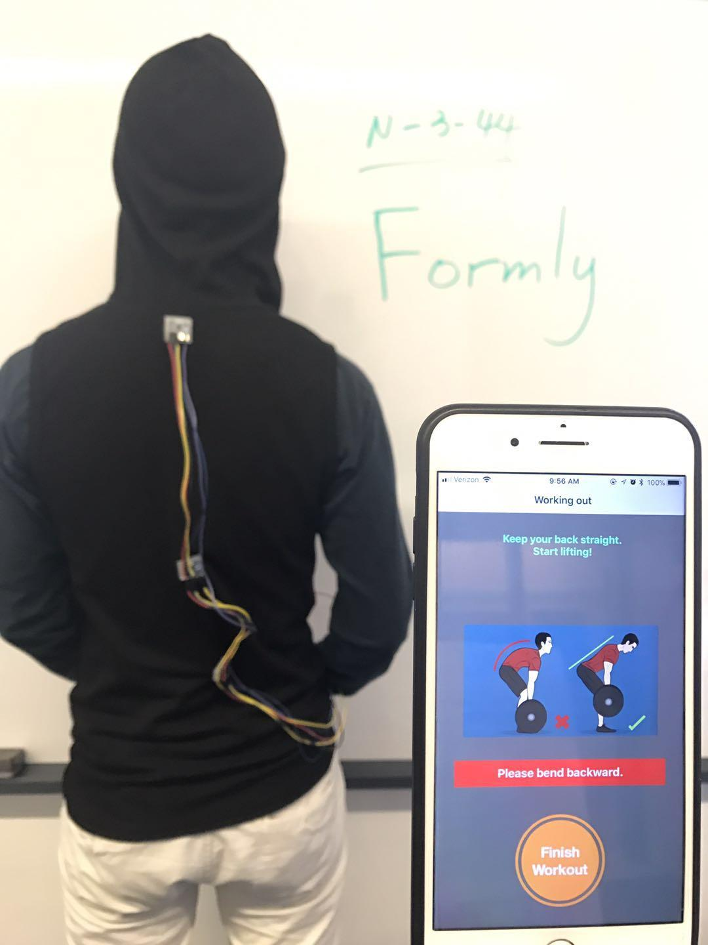
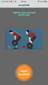
Formly
Xiaoyi Chen
Fangyi Fan
Qiaochu Guo
Xiaoya Song
Hanming Zu
Team Number N3-44

Slide 23
Peri
Christian de Abreu
Fabian Louis
Leo Kensicher
Nikhil Krishnan
Bernardo Penteado
Alejandro Villasmil
Team Number M1-1

Slide 24
Instahub
Dayo Adewole
Matthew Hanna
Michael Wong
Team Number M2-2

Slide 25
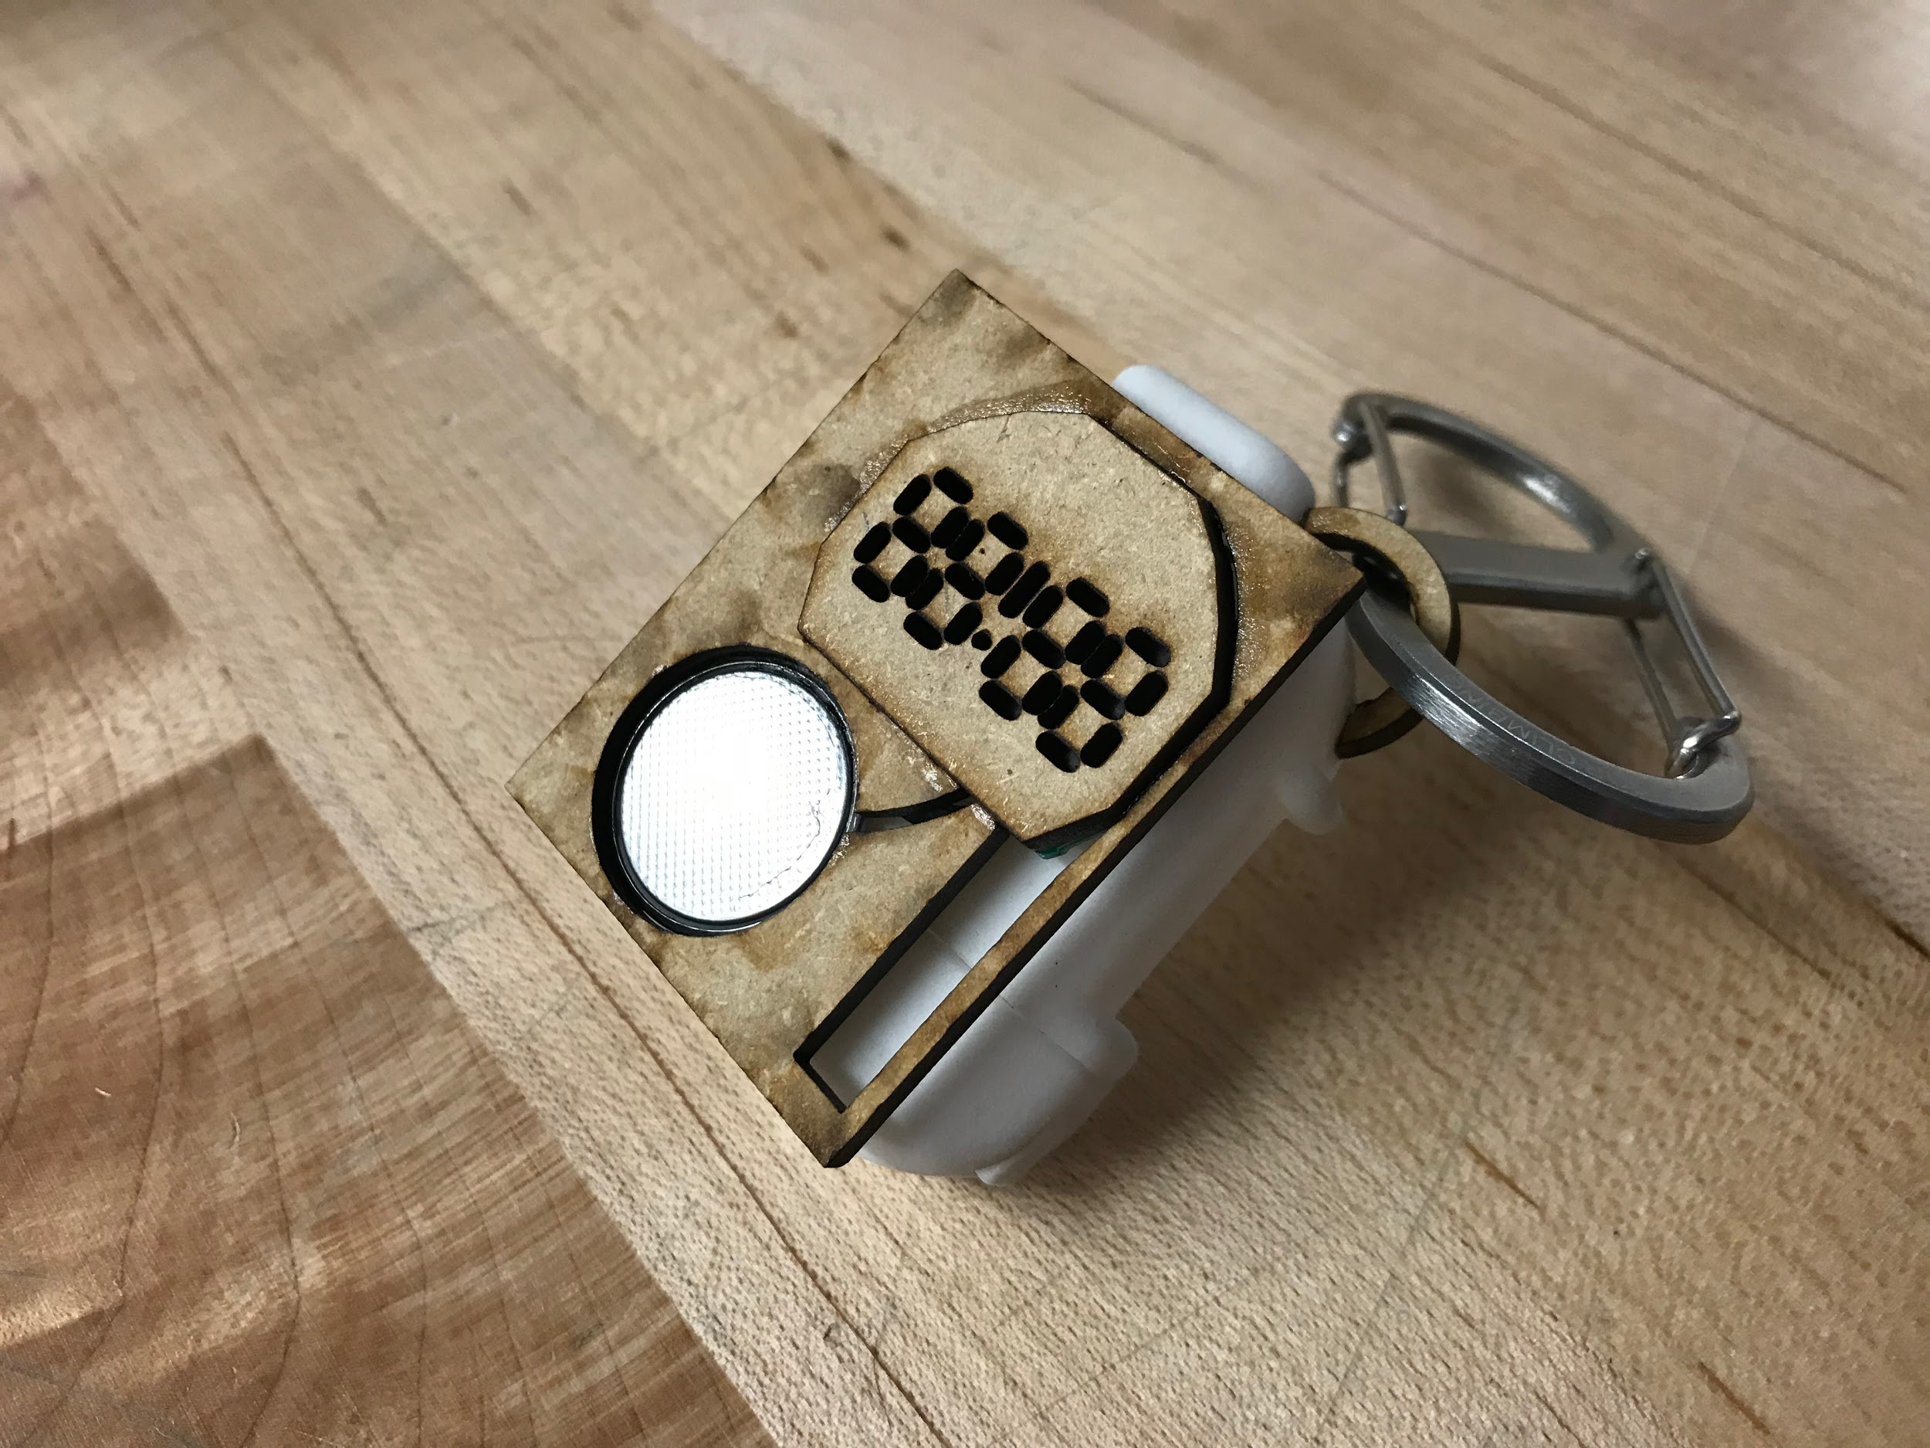
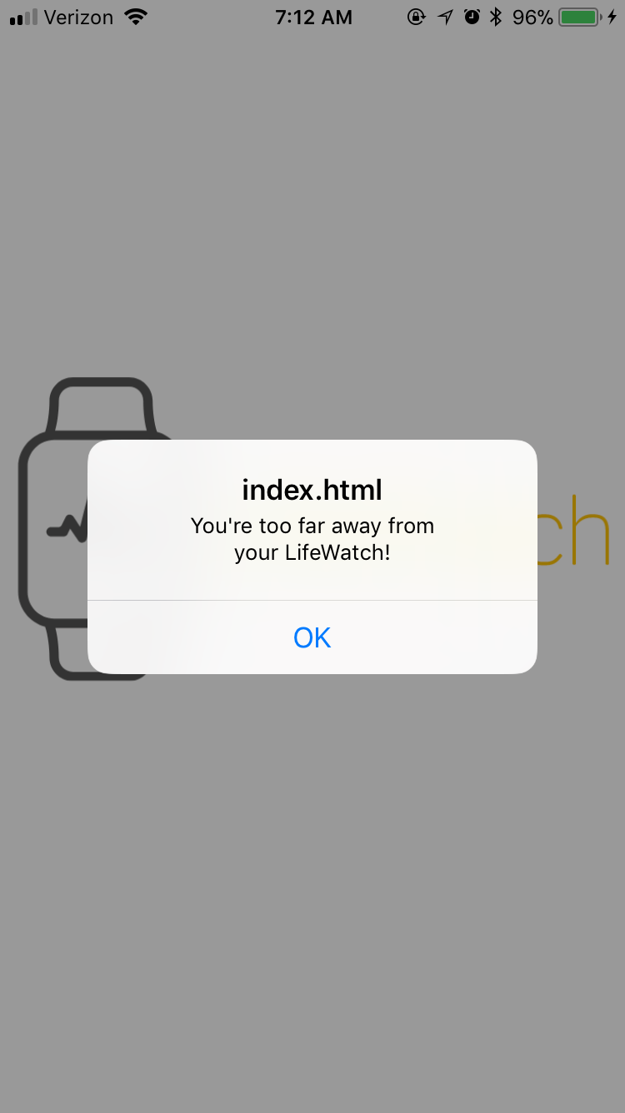
EpiPenn
Ben Bernstein
Reed Ginsberg
Daniel Orol
Team Number M3-12

Slide 26
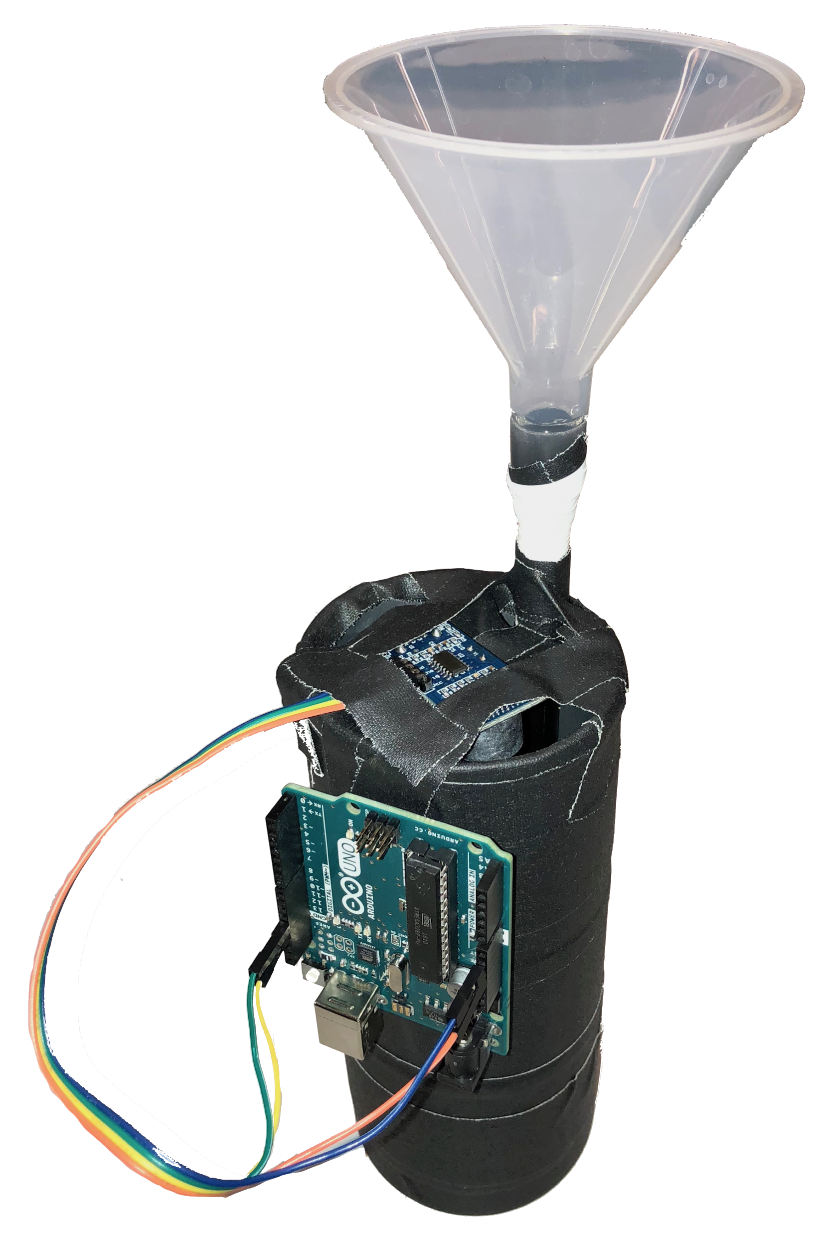
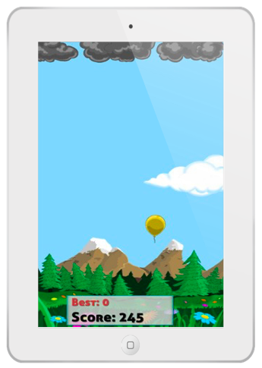
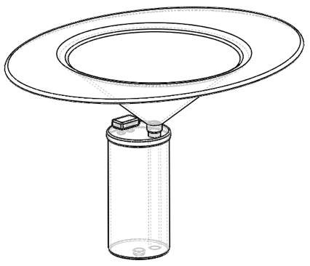

Dr. Toilet
An affordable, non-invasive device designed to visualize urine flow in real-time at home, which can help children with lower urinary tract dysfunction (LUTD) by self-educating themselves on a cartoon app.
Team Number M3-14: Thomas Borgese, Brett Garberman, Qizhi Lai, Xin Liu, Anjali Maheshwari

Slide 27
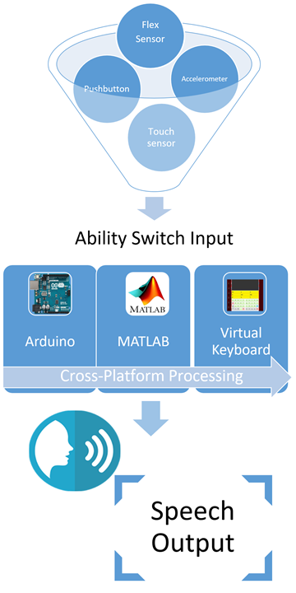
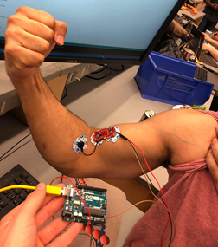
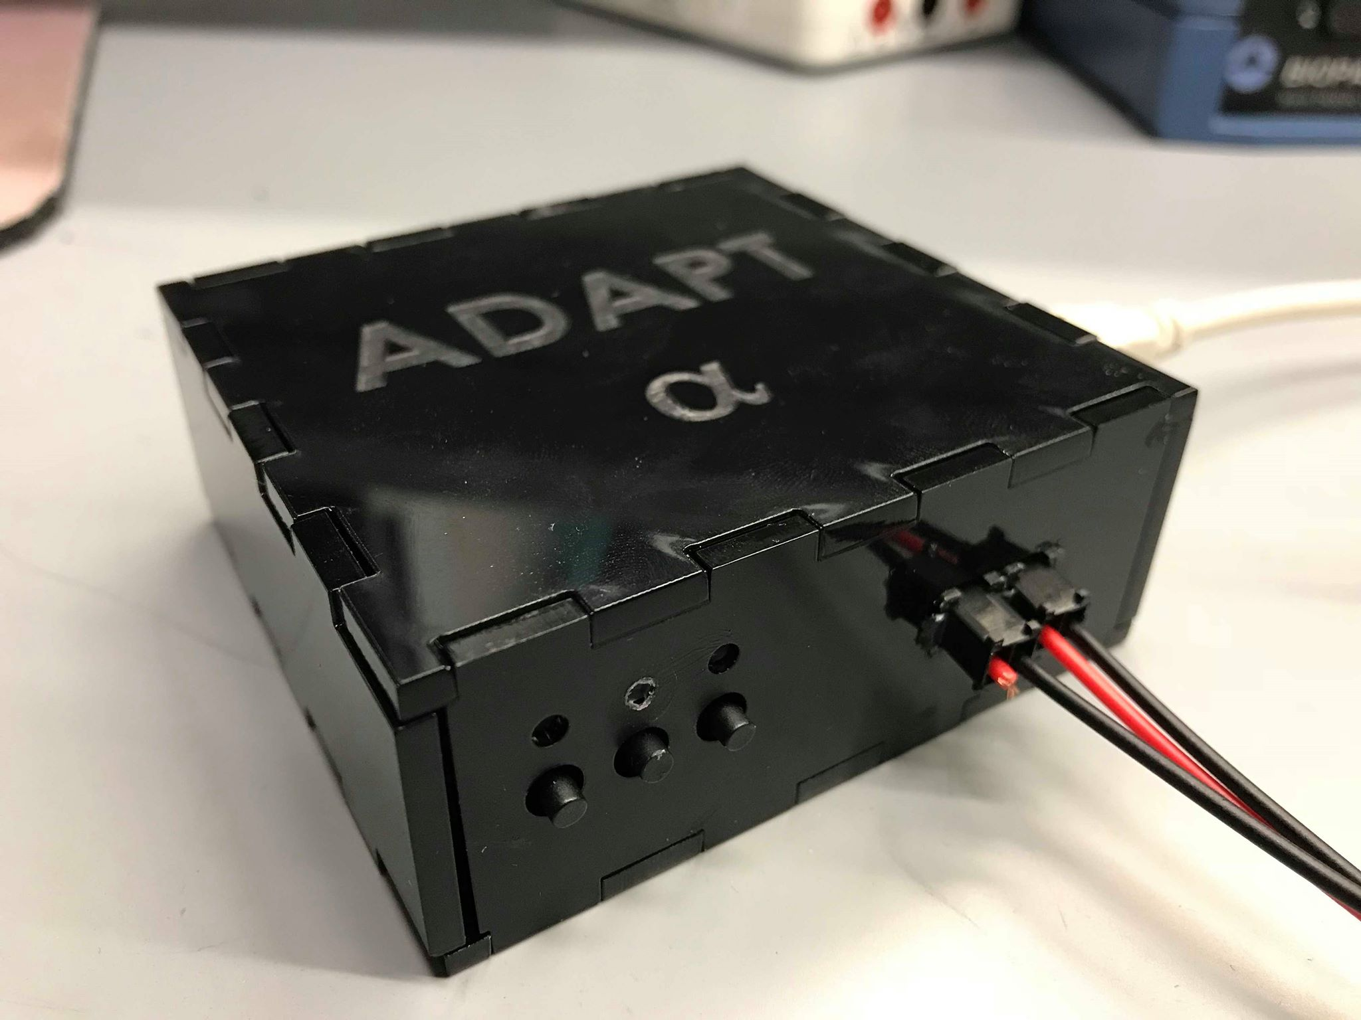
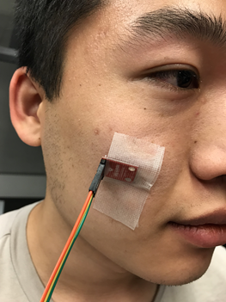
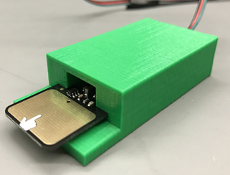
ADAPT Alpha
An augmented communication tool for ALS patients that improves quality of life and autonomy.
Arjun Dave
John Forde
Asaph Kupferman
Rohit Shinde
Teddy Wang
Team Number M3-18

Slide 28
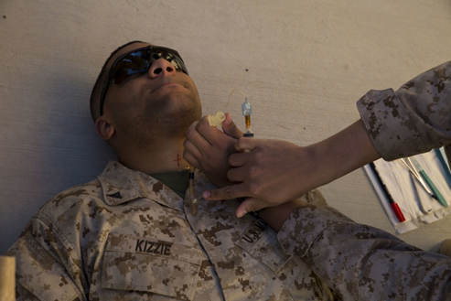
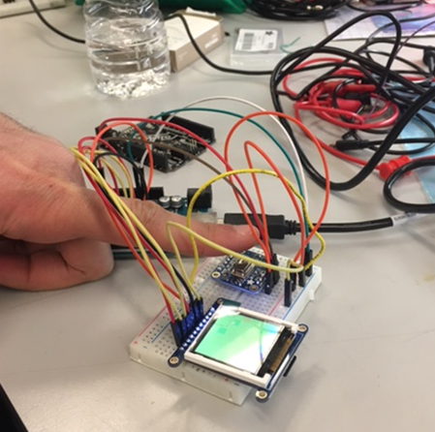
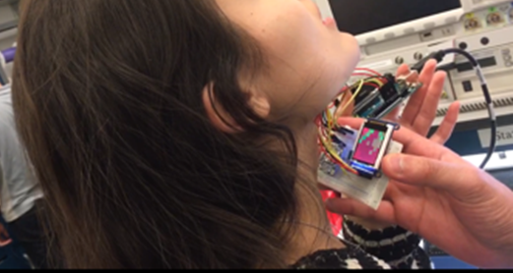
Auto Trach
Automating the Cricothyrotomy
Problem: High military cricothyrotomy error rate
Minimal user training
Obscured patient anatomy from trauma
Stressful environment
Solution:
Automated detection of trachea
Infrared thermal sensor
Team Number M3-21
Ahmed Aly, Laura Ceccacci, Jacquelyn Trujillo

Slide 29

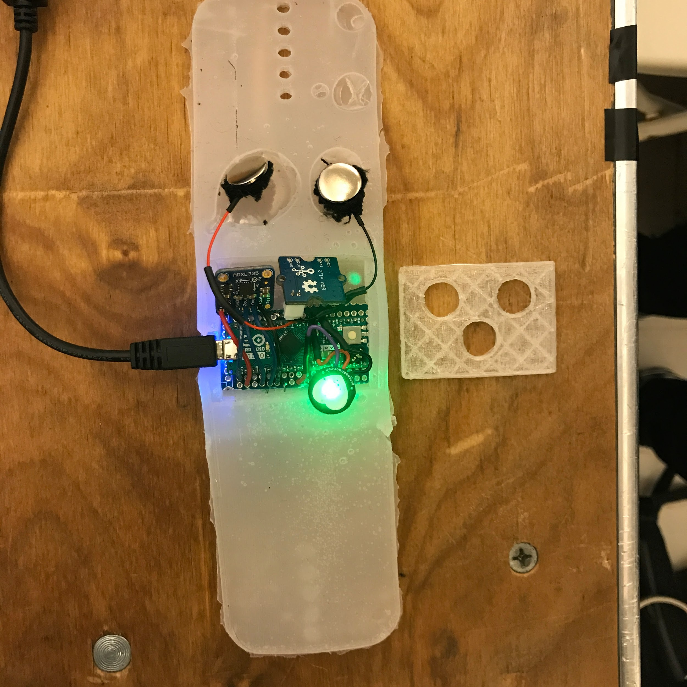
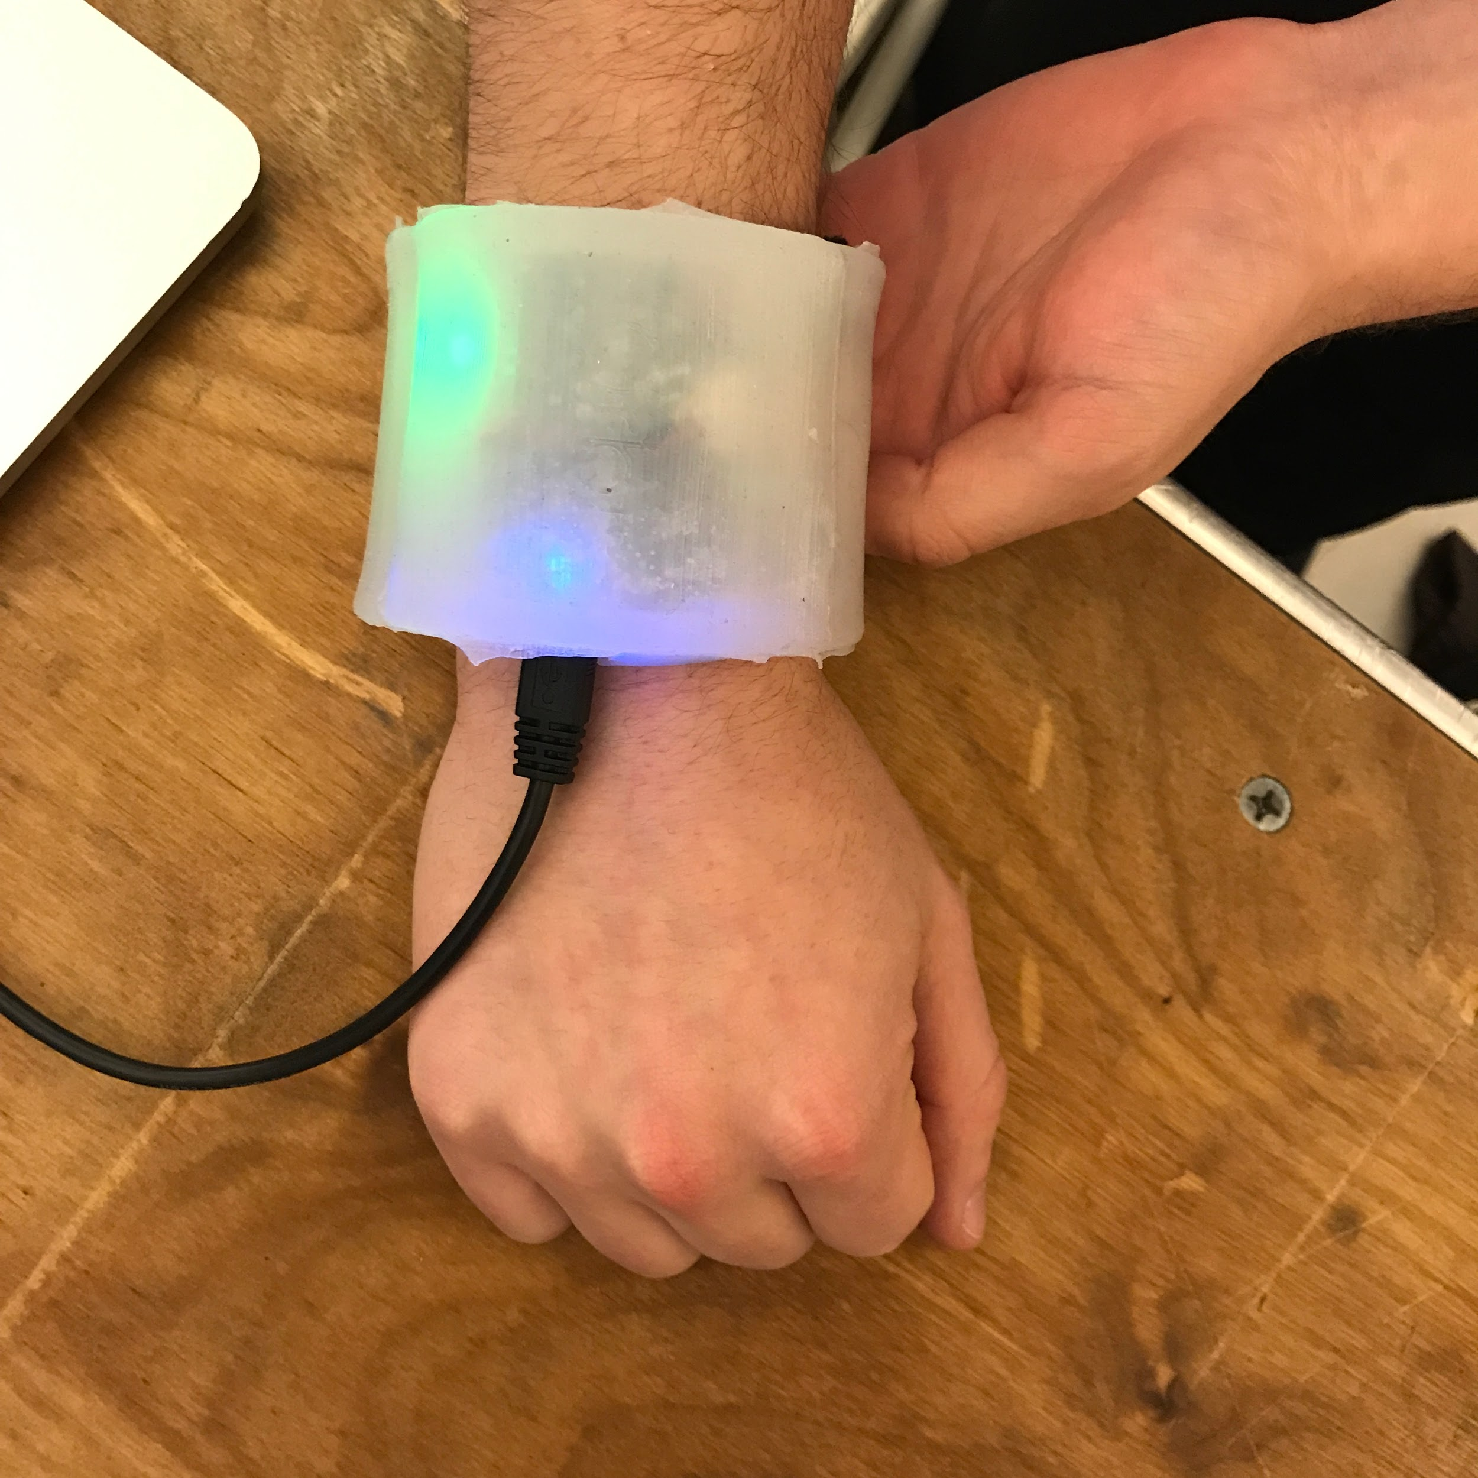
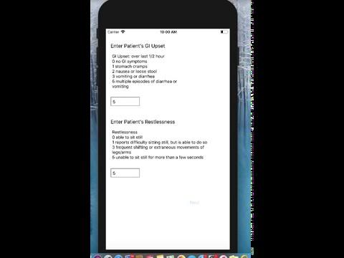
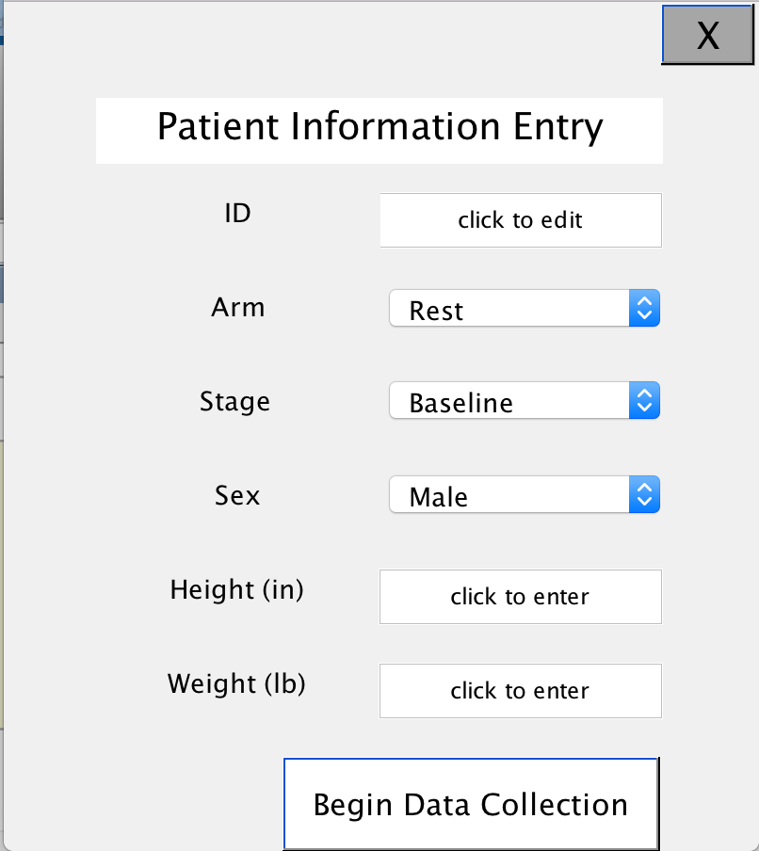
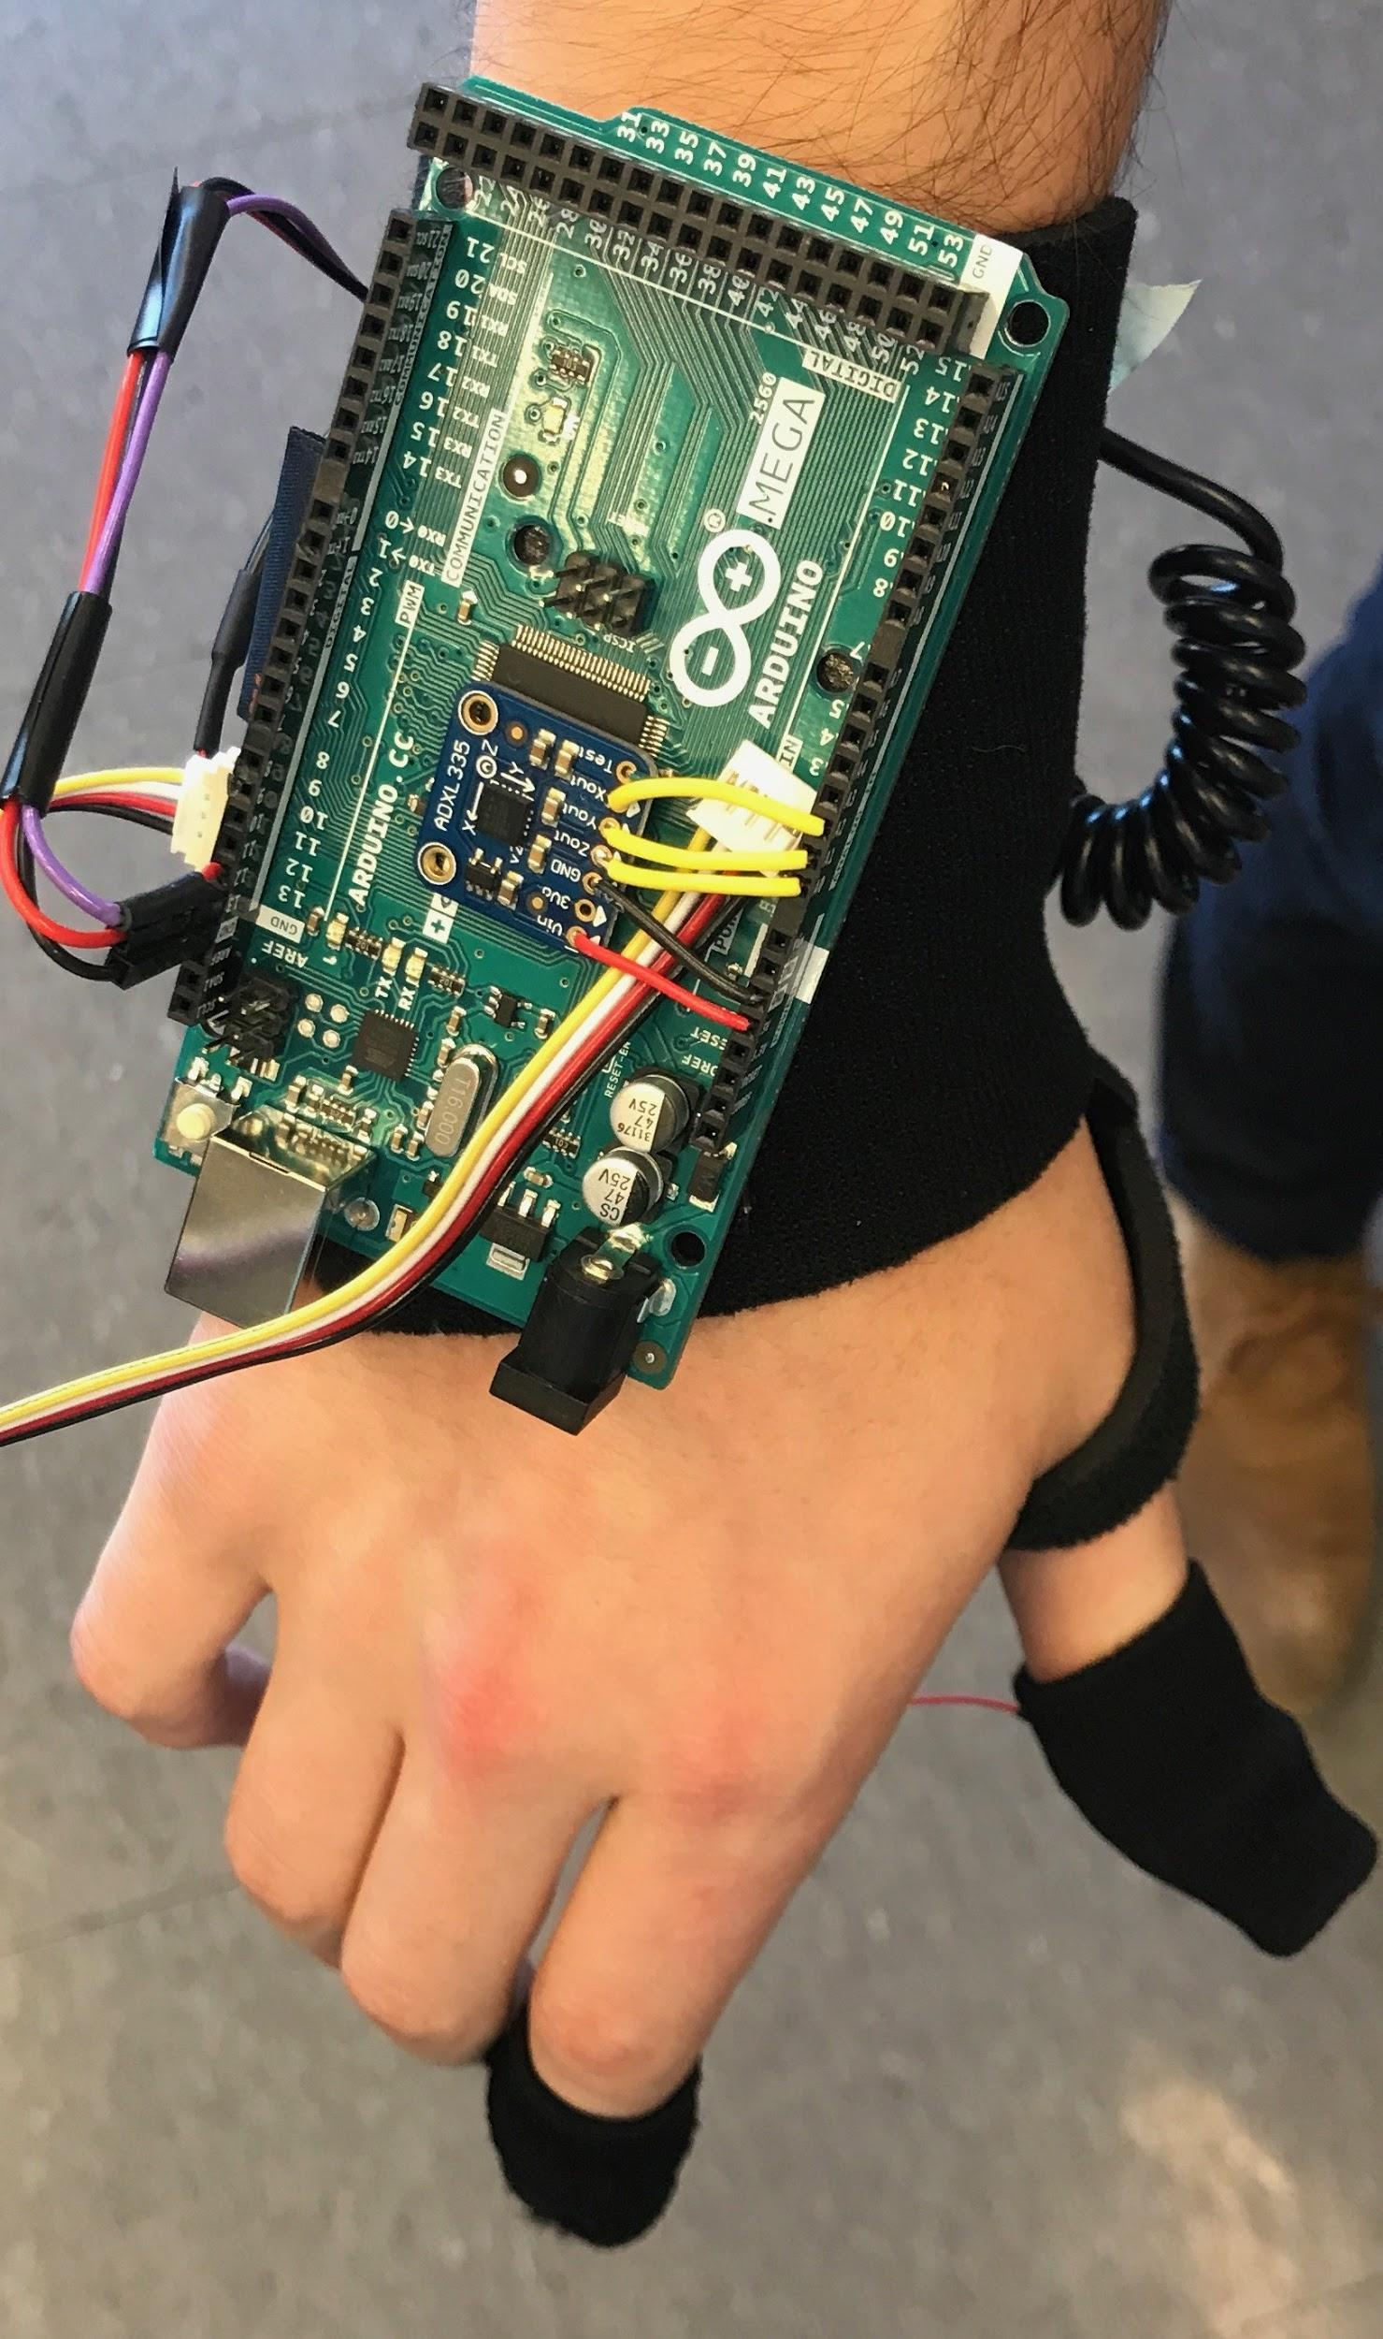

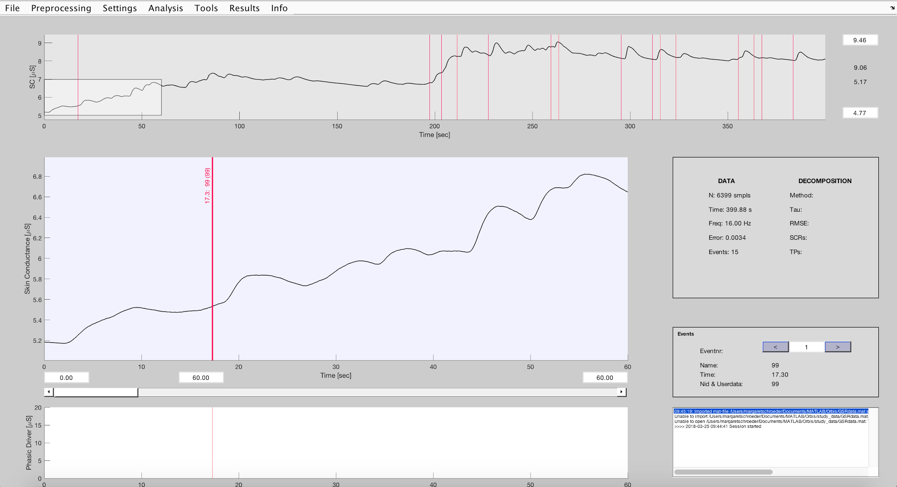
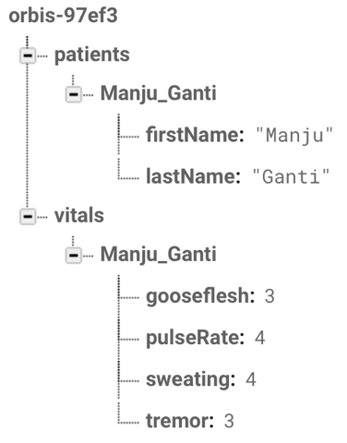

BEFORE
Team Number M3-31
Manju Ganti, Eric Helfgott, Kyle O'Neil,
Chris Painter, Margaret Schroeder

Slide 30


